Slide 1
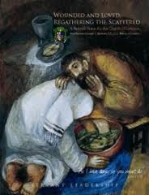
communio and missio
Understanding the PARISH and the PARISH PASTORAL COUNCIL Through the Lens of

Slide 2
LUMEN GENTIUM 8
The one mediator Christ, established and ever sustains here on earth his holy Church, the communion of faith, hope and charity as a visible organization.
The 1985 Synod of Bishops proclaimed the ECCLESIOLOGY OF COMMUNION as the central and fundamental idea of the Vatican II documents.

Slide 3
Pope Benedict XVI
“It is in the concept of communion that theology in our own day has found the key for approaching the mystery of the Church…a Sacrament of intimate union with God and of the unity of the whole human race.”
Dec. 12, 2007
General Audience

Slide 4

A WAY OF BEING
The Church as communio is a way of existence, a way of being.
As a baptized member we take on God’s way of being which is a way of relationship with the world, with other people, with God. John D. Zizioulas
Being as Communion

Slide 5
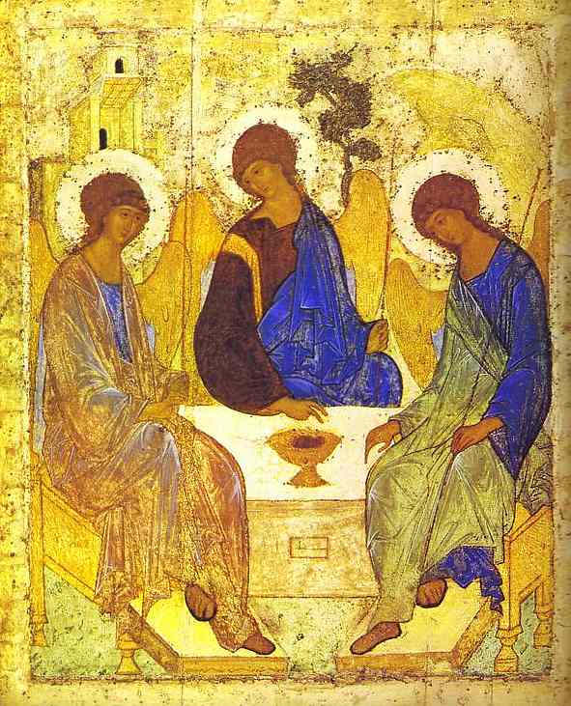

Slide 6
OTHER IMAGES OF COMMUNION
We are all baptized into one Body (Cor. 12)
The Vine and the Branches (John 10)
I am the Good Shepherd, I know my sheep and mine know Me (John 15)

Slide 7
NOVUS HABITUS MENTIS
The parish is not a place where…
But a people who...

Slide 8

We Are All In This Together
The Church is an event of communion, and that is why it cannot be realized as the achievement of an individual.
A parish must undertake to grow in Christ not only as individuals but also as a parish faith community.
A parish must undertake to grow in Christ not only as a parish but also as part of the local church, the Diocese of Scranton.

Slide 9

SUNDAY EUCHARIST
Communio is made most visible at Eucharist, the most intensive event for the Church.
Eucharist celebrates who we are: the Body of Christ…a Holy Communion.

Slide 10
Multicultural Communion
“Humanity is realized not in each individual human being but rather in communion among all humans, in and through their viable cultures.”
Charles Taylor
Canadian Catholic Philosopher
The Politics of Recognition

Slide 11
Whoever enters into communion with the Lord…
is expected to bear fruit!
The Amen of the liturgy makes demands beyond the Kiss of Peace!

Slide 12
COMMUNION GIVES RISE TO MISSION
Communion and mission are inseparably connected.
Where communion is weakened, mission suffers.
John Paul II
The Church is missionary by her very nature. It is not that the Church has a Mission, but the Mission has a Church!

Slide 13
JESUS’ MISSION STATEMENT
The spirit of the Lord is upon me…
To bring glad tidings to the poor
To proclaim liberty to captives
Recovery of sight to the blind
To let the oppressed go free…
Lk.4:16-21

Slide 14
MISSION: WHY THE CHURCH EXISTS
Mission is the organizing principle for the Church. If the Church is essentially organized toward mission it follows that the church must be prepared to appraise her rules and structures in the light of this reason for her existence. Canonist, James Coriden

Slide 15
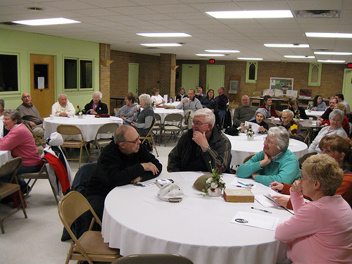
PARTICIPATION IN MISSION
IS THE ESSENCE OF COMMUNION !

Slide 16

Questions for Clarification

Slide 17
PASTORAL LEADERSHIP
The parish pastoral council is the appropriate structure that insures fullest possible collaboration of clergy, laity, religious men and women in the common mission of the Church.
Wounded and Loved, p. 13

Slide 18

The Sole Function: Pastoral Planning
Canon law suggests that the parish pastoral council is the vehicle for planning.
Canons 511-514
Investigate pastoral matters, consider, propose.

Slide 19

PASTORAL PLANNING IS
both a practical and spiritual process that through a deliberate and disciplined study of the future, pastors and parish leaders empower all in their charge to carry out the Mission of the Parish .
Notes:
2

Slide 20
Parish Pastoral Planning Cycle
Focus
Information
Identify
Concerns
and Issues
Engage
Parish
Revise &
Create
Goals
Gather
Information
Create
Objectives
Evaluate
Mission
Implement &
Assess
Engage
Parish

Slide 21
Parish Pastoral Planning Cycle
Focus
Information
Identify
Concerns
and Issues
Engage
Parish
Revise &
Create
Goals
Gather
Information
Create
Objectives
Evaluate
Mission
Implement &
Assess
Engage
Parish

Slide 22
THE SIGNS OF THE TIMES
The investigation and research stage of pastoral planning is key to arriving at goals that are both compelling and appropriate for a particular parish’s pastoral needs.
Attention should be given to:
Quantitative Data
Qualitative Data

Slide 23
Investing the Parishioners
Parish Assemblies
Focus Groups
Appreciative Interviews
Surveys
Methods
Wording questions

Slide 24
Understanding the Context
Tasks
Planning Your Research
Gather the Data
Analyze and Summarize the Data
Interpret the Data
Sources
MissionInsite

Slide 25
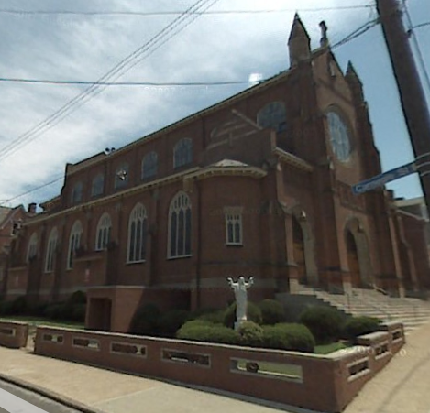
“Discover The Story”
Population Trends
Age Trends
Income Trends
Generational Trends
Diversity
Lifestyle Trends

Slide 26

Population Trends
- 3.4%
The Cluster experienced constant decline in population over last 17 years
Decline is expected to continue but slow over the next 5 years
State population is projected to increase slightly over the next 5 years

Slide 27
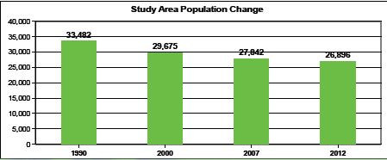
Population Trends
Steady Decline Projected

Slide 28
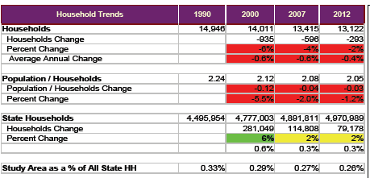
Households
-2%
The number of households and population/household are expected to decrease slightly over the next 5 years

Slide 29
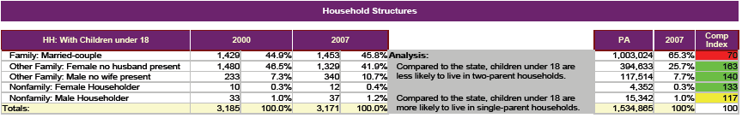
Households Raising Children
Traditional households, Married Couples, make up almost 46% of the Households raising children under 18
“Single parents” make up almost 53% of Household units raising children under the age of 18. State Avg. 33%

Slide 30
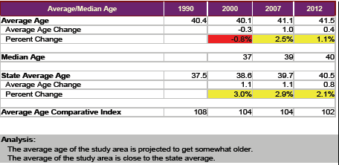
Age Trends

Slide 31
Poverty Level
Poverty Level for the Cluster is more than twice the States average 7.8%
Largest Group living below the poverty level are “Married Couples no children”

Slide 32
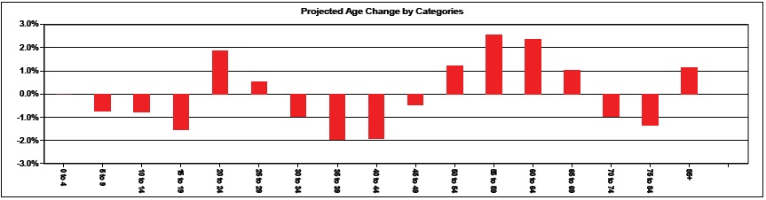
Projected Age Change
Reduction in “School age” Children
Aging Baby Boomers
6,800+
Increase in the 85+ group
The Increasing population of the 85+ group creates increasing needs for In-home services (spiritual, medical, physical)
Notes:
32

Slide 33
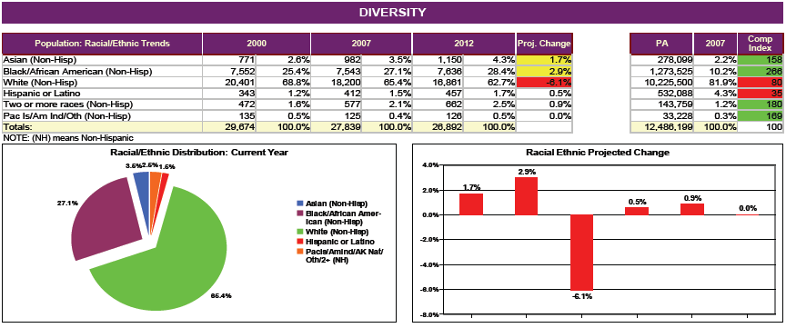
Diversity Racial/Ethnic Trends
-6.1%
Projected decrease in the white population and increases in the Black and Asian population

Slide 34
Significant “life concerns” of the area:
Aging population and the anticipated increased need for in-home services (medical, physical and spiritual)
Young educated people moving away for employment opportunities or a better life leaving aging parents/grandparents behind
Economic stability in the form of good jobs is critical to the vitality of the area however manufacturing jobs have been leaving the area.
Reported increase in the number of single mothers raising children
Low number of youth and adults attending Mass or involved with church ministry.
Relatively large number of “singles” in the area in all age groups. What are we doing to connect with them?

Slide 35
Reflection Questions:
Name the obstacles that hinder growth toward a mission motivated planning process in our parish.
What part does our attitude as leaders play when roadblocks are met?

Slide 36
Councils are Not Optional
A parish, diocese needs councils in order to insure that it is truly faithful to the mission of Christ.
Yves Congar insisted that the church at its very core is conciliar.
Laity and clergy in communio and missio.

Slide 37
Truly Pastoral
“It may well be that we will see emerging a true pastoral council on the parish level, leaving the development and coordination of ministerial committees and apostolic lay organizations to parish staff, thereby avoiding the growing sense of boredom on parish super-councils where the only action month after month is hearing reports from committees, commissions and organizations each having a reserved seat on the board.” Canonist Bertram Griffin Code, Community, Ministry

Slide 38
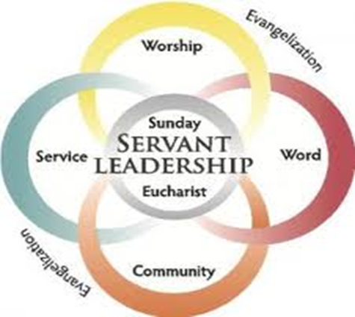
ITE MISSA EST!

Slide 39
IN SUMMARY
Communion is not a vague notion or abstract ideal, but finds expression in various concrete experiences. The bishop is to promote this with the help of priests, deacons, religious and lay people by implementing a coordinated pastoral plan which is systematic and participatory involving all of the members of the Church and awakening in them a missionary consciousness. Ecclesia in America #33

Slide 40
It is our turn…
In every age, the Church carries the responsibility of reading the signs of the times and of interpreting them in light of the Gospel if it is to carry out its task.
Gaudiam et Spes

Slide 41
Remember… Relationships
The most important thing about councils has less to do with vision and goals, but the process of dialogue and consultation that create the vision and goals!
The parish pastoral council ought to be a model of communio for the entire parish!

Slide 42
Let’s Make It Personal
What insights did you gain from the presentation that you could share?
What questions or clarifications do you have?
What will have to change in your parish in order to achieve full, active, and conscious participation of the faithful in the life and mission of the Church?

Slide 43

Thank You for Listening…
It has been a privilege and honor to share with you in communio!
May we walk together into the future with the hope and confidence of the Holy Spirit!

