Slide 1

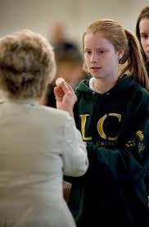
Serving as an Extraordinary
Minister
of Communion
at Mass
Notes:
We begin this third session by taking an in-depth look at serving as an Extraordinary Minister of Communion at Mass. ()

Slide 2
Attire
  “Bodily demeanor (gestures, clothing) ought to convey the respect, solemnity and joy of the moment when Christ becomes our guest” (CCC 1387b).
  Dress in a way that is dignified and shows respect for the Blessed Sacrament and your function as an Extraordinary Minister
    “Sunday best”
    Nothing that calls attention to the minister
      Logo shirts or revealing clothing
      Extravagant jewelry
      Over the top manicures
    Shoes that allow quiet and reverent movement
    Refrain from strong perfume or cologne.
Notes:
We will start with your preparations at home. () The first is your attire and what you will wear for your ministry. ()
The Catechism of the Catholic Church tells us that “Bodily demeanor (gestures, clothing) ought to convey the respect, solemnity and joy of the moment when Christ becomes our guest” (1387b). ()
In other words, you want to dress in a way that is dignified and shows respect for the Blessed Sacrament and your function as an Extraordinary Minister of Communion. That would include: ()
Your “Sunday best” ()
Nothing that calls attention to the minister ()
No logo shirts or revealing clothing ()
No extravagant jewelry ()
No over-the-top manicures ()
Shoes that allow for quiet and reverent movement ()
Refraining from wearing strong perfumes or cologne. ()

Slide 3
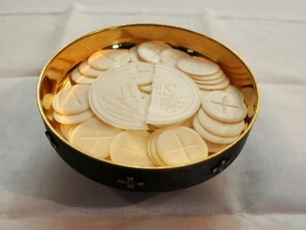




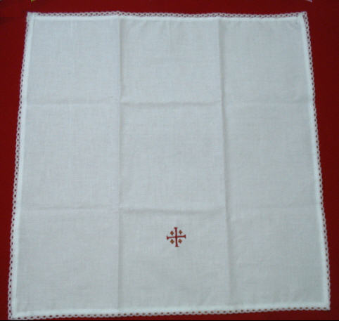
Identify the Items Used
  Paten
  Ciborium/ciboria
  Chalice/cups
  Purificator
  Corporal
Notes:
Before you serve in your ministry, you also want to know the names and identify the items that you will be using at Mass. ()
The paten is the plate that the priest uses to hold a single host, or a small amount of hosts. Sometimes used to refer to bowl ciborium. ()
Ciborium or bowls used to hold the Precious Body. ()
Chalice or cups used to hold the Precious Blood. ()
The purificator is the rectangular folded cloth used to wipe the lip of the chalice or cup and to dry after purification. ()
The corporal is the square cloth on which the Eucharistic elements are placed. Its purpose is to catch any fragments or particles of the Precious Body. ()

Slide 4
Procedure before Mass
  Every parish should have clear, written check-in procedures
    Where and how to check in
    Diagram of Communion stations
    How to prepare hosts and wine (if EMs responsibility)
    Deacon is the minister of the Precious Blood
    Planned arrangement for reception of Communion
      Music Ministers
      Persons with disabilities
  Arrive at least 15 minutes early for your ministry
  Note the station and position you are assigned
Notes:
Once you complete this general training and formation here, you should receive specific training in the procedures of serving as an Extraordinary Minister of Communion in your parish. Every parish has different ways of carrying out this ministry, so you should find out the following: ()
First, every parish should have clear, written check-in procedures () that includes where and how to check in, () a diagram of Communion stations, () and how to prepare the hosts and wine if that is the responsibility of the Extraordinary Minister of Communion. () It is important to note that the deacon is the minister of the Precious Blood, so he should be assigned to this position before being assigned to hosts. () You should inquire as to the arrangement for the reception of Communion by the music ministers and persons with disabilities. () Please arrive at least 15 minutes early for your ministry, () and finally, note the station and position you are assigned. ()

Slide 5
Procedure before Mass
  Vest in an alb
    Symbolic white garment from baptism
    Reminder of our call to serve
    Tradition in the Diocese of Scranton
    Should properly fit (ankle-length)
    Parish usually provides, although you can purchase your own
  Hands clean
    Wash your hands prior to ministry
    Hand sanitizer
    Avoid touching your face, hands, mouth and nose
Notes:
Extraordinary Ministers of Communion should vest in an alb when they are scheduled to serve at Mass. ()
An alb is a white garment worn during the Mass that is symbolic of baptism. () After we were baptized we received a white garment, which is a sign of our Christian dignity, and also a reminder of our call to serve. ()
Wearing an alb when serving is the tradition in the Diocese of Scranton. () When finding an alb to wear, it should properly fit, being about ankle-length. () The parish usually has a supply of albs that Extraordinary Ministers of Communion can choose from whenever they serve at Mass, although you may prefer to purchase your own. ()
As part of your ministry, make sure your hands are clean. () Please wash your hands prior to your ministry, () or use hand sanitizer which many parishes provide in the sacristy. () During the Mass, please refrain from touching your face, mouth, and nose, as this increases the likelihood of spreading germs. ()

Slide 6

Procedure before Mass
  Minister of Hospitality
  Sitting in church
    Close to the sanctuary
    End of the pew
    Reserved seating
  Prepare internally before Mass
Notes:
In some parishes once they are vested, Extraordinary Ministers of Communion are invited to serve as Ministers of Hospitality and greet parishioners as they enter church, and then are seated five minutes before Mass. ()
When you are seated in the church, () please try to sit up front, close to the sanctuary area, () preferably at the end of a pew, so that you can exit and return easily. () Some parishes have reserved seating for Extraordinary Ministers of Communion in the first pew closest to the sanctuary. Please find out the seating arrangements for your particular parish. ()
Once your are seated, spend some time preparing internally through prayer and quiet reflection before Mass. ()

Slide 7
Participation during Mass
  The obligation of Catholic Christians is not simply to “attend” Mass but to “participate in” (Canon 1247)
  “Individual right and duty to contribute their participation” (CSL 14) and the most fundamental expression of our lay ministry is the “conscious and fruitful participation in the mystery of Christ.” (GIRM intro #5)
  Extraordinary Ministers of Communion should model proper participation for others
  Bowing and genuflecting at appropriate times
Notes:
As mentioned in the first session, your participation at Mass is extremely important, for Canon Law states, () “The obligation of Catholic Christians is not simply to “attend” Mass but to “participate in” (1247). ()
The Constitution on the Sacred Liturgy tells us that it is the right and duty of the Christian people to contribute their participation and the General Instruction of the Roman Missal states that the most fundamental expression of our lay ministry is the “conscious and fruitful participation in the mystery of Christ” (intro #5). ()
As Extraordinary Ministers of Communion, you are called upon to model that proper participation at Mass for others. ()
As mentioned before, the specific gestures of bowing and genuflecting at the appropriate times is also important to the reverence of the ministry. ()

Slide 8
Distribution of Holy Communion
  DO NOT HURRY YOUR ACTIONS!
  Approach the altar once the priest has consumed the host
    Know what vessel you are to receive
    Know specific position to stand for each minister
    Priest or deacon will hand you your vessel
      Host ministers will receive ciborium/bowl
      Precious Blood ministers will receive chalice and purificator
      Distribution should begin when the priest is in place
Notes:
The overall guiding principle when distributing Holy Communion: () DO NOT HURRY YOUR ACTIONS! ()
Extraordinary Ministers of Communion should approach the altar once the priest consumes the host. ()
When approaching the altar, you should know what vessel you are to receive, () and know where you should stand to receive that vessel (i.e. hosts stand here, cups stand there) so as to not confuse the (visiting) priest. ()
Once you have received Holy Communion, the priest or deacon will hand you your vessel: () host ministers will receive a ciborium or bowl, () and those ministering the Precious Blood will receive the chalice or cup and purificator. ()
Once the priest has handed on all the vessels, he then proceeds to his Communion station, and all the Extraordinary Ministers proceed to theirs and begin distributing. ()

Slide 9
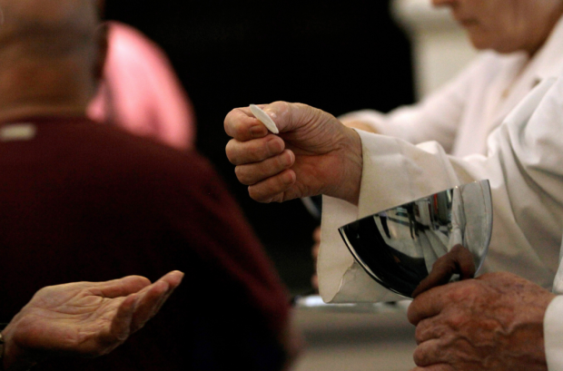
Distribution of Holy Communion
  The Communicant has the option to receive:
    In the hand or mouth
    To receive from the cup
  Should bow slightly before receiving
  Should not be denied if kneeling to receive
    Normal posture is standing
    Pastor should address such instances
Notes:
For your information, () the Communicant has the option to receive either in the hand or the mouth, () and to receive from the cup. ()
The communicant should bow slightly before receiving the Eucharist out of reverence for the sacrament. ()
On occasion, you may have a communicant that kneels down to receive Holy Communion. While that person should not be denied the sacrament for kneeling, () the normal posture for communicants is standing. () Such instances should be addressed by the pastor outside of Mass. ()

Slide 10
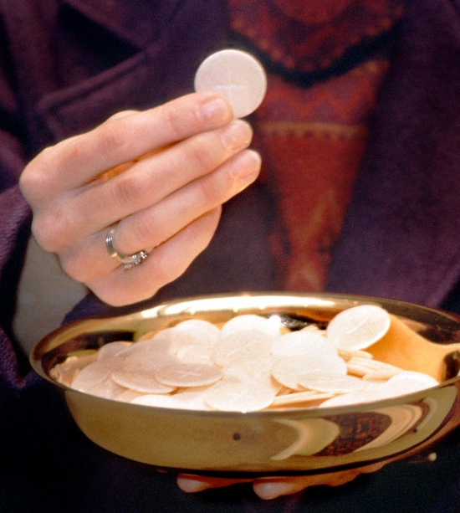
Distribution of Holy Communion
  Distributing the Precious Body
    Picking up the host
    Hold host over the ciborium
    Eye contact
    Exact wording: “The Body of Christ” “The Blood of Christ”
      Announce with meaning and faith
      No names—you are already saying their names as a member of the Body of Christ
    If not said, say “Amen.”
    Overhand placement (recommended)
    Underhand placement
    Blessing of children or adults is discouraged
Notes:
When distributing the Precious Body, () use your dominant hand to pick up the host with your thumb and index finger, () and hold the host over the ciborium. () Establish eye contact with the communicant. He or she may not look you in the eye, but eye contact sets up that powerful expression of faith. () The exact wording, “The Body of Christ” must be used, () and should be announced with meaning and faith. () No names are to used when distributing to the communicants. () If he or she fails to say “Amen”, say it for them as a reminder. They may have forgotten the response or be distracted in the moment, and some may say it very quietly, so use your judgement. ()
The overhand method of placing the host on the tongue or hand is recommended. This involves twisting the wrist so that the hand turns and the host can be firmly placed on the tongue or in the palm of the hand using the index finger. () Use the underhand placement if you are more comfortable with that method. ()
The blessing of children or adults is to be discouraged. Everyone will receive a blessing by the priest before the dismissal of the Mass. ()

Slide 11
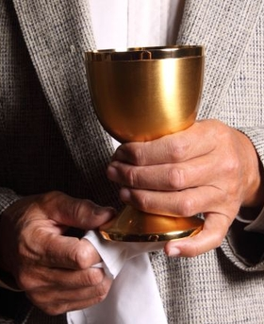
Distribution of Holy Communion
  Administering Precious Blood
    Wait for bow, establish eye contact, and say “The Blood of Christ”
    Carefully hand the cup to communicant
      Be sure communicant has a good grip
      Exchange should be firm, but gentle
      Communicant should take cup with both hands
      In case of disability, assistance may be needed
      Do not try to force them to drink
    Take back, wipe and turn
      Wipe inside and outer lip of the cup where lips made contact
      Don’t dip purificator in Precious Blood
      Turn cup a quarter turn to air dry
Notes:
When administering the Precious Blood to the faithful, () wait for them to bow first, establish eye contact, and say the words “The Blood of Christ” with faith and meaning. () Great care should be used when handing the chalice to the communicant. () Be sure that he or she has a good grip. () The exchange should be firm, but gentle. () The communicant should take the cup with both hands. () In case of someone with a physical disability, assistance with offering the cup may be needed. () Do not try to force anyone to drink from the chalice—doing so could result in spilling the Precious Blood. ()
Once the communicant has received from the chalice, take it back, wipe the lip with the purificator and turn. () Be sure to wipe the inside and outer lip of the cup where the communicant’s lips made contact. () Be careful not to dip the purificator in the Precious Blood, () and after wiping turn the cup a quarter turn to allow it to air dry. ()

Slide 12
Distribution of Holy Communion
  If you are running out of hosts:
    Go to the priest or deacon to refill ciborium
    You may break hosts if there are only a few people left
  When finished distributing Precious Body:
    Can move to assist others distributing
    Return your ciborium to the altar
  When finished distributing the Precious Blood:
    Consume leftover Precious Blood while still in place and facing the altar. (indult granted by Bishop of Scranton) and return cup to the appropriate location
    Precious Blood should NEVER be poured down a sacrarium
    If you run out of Precious Blood, return your cup to appropriate location
Notes:
If you are running out of hosts, () you can either go to the priest or deacon who will refill your ciborium, () or you may break hosts if there are only a few people left in line. ()
When finished distributing the Precious Body, () you can move to assist others who are still distributing, () or if assistance is not needed, you can return your ciborium to the altar. ()
When you are finished distributing the cup, () you may consume any leftover Precious Blood while still in place and facing the altar (this is an indult granted by the Bishop of Scranton), and return the cup to the appropriate location. () Any remaining Precious Blood should NEVER be poured down a sacrarium. ()
If you run out of Precious Blood during the Communion procession, simply return your chalice to the appropriate location.
Please consult your pastor or liturgical ministry coordinator for parish adaptations to these guidelines. ()

Slide 13
Purification and Washing of Vessels
  Ordinary ministers of Communion purify the vessels.
    Should be done at the altar during Mass or at a side table after Mass
    Extraordinary Ministers of Communion may assist with the washing of the vessels in the sacristy after Mass
    Take care in handling the vessels
      Watch jewelry to prevent scratching
      Carry the vessel reverently because of its sacred use
  Place any used purificators or corporals in separate container designated as “sacred wash”
  Guiding principle: reverence for the Lord’s Body and Blood
Notes:
After Mass, the purification and washing of vessels takes place () by the ordinary ministers of Communion, () and it should be done at the altar during Mass or a side table after Mass. This involves wiping the Eucharist particles into the chalice, pouring water into the chalice, consuming the water containing the particles, and drying the chalice out with the purificator. ()
Extraordinary Ministers of Communion may assist with the washing of the vessels in the sacristy after Mass. () When washing them, take care in handling the vessels, () be careful of any jewelry that you are wearing to prevent scratching, () and carry the vessel reverently because of its sacred use. ()
Place any used purificators or corporals in separate containers or bags designated as “sacred wash.” Inquire where your parish keeps this. ()
The guiding principle in all of these actions: reverence for the Lord’s Body and Blood. ()

Slide 14
Accidents or Problems
  If a consecrated host is dropped:
    Pick it up reverently and consume right away
    Hold under the ciborium, return to altar and tell the priest
    The dropped host should never be placed back in the ciborium
    If host cannot be consumed, it may be completely dissolved in water and poured down a sacrarium
  If Precious Blood spills:
    DO NOT PANIC—stop what you are doing and do not embarrass the communicant
    Place the purificator over the spill and position yourself over
    Absorb the Precious Blood and rinse with water in the sacrarium.
    If no sacrarium, rinse in another vessel and that water poured into the ground in a secluded spot
Notes:
Potential accidents or problems that you might encounter in this ministry: ()
First, if a consecrated host is dropped: ()
you can either pick it up reverently and consume it right away () or you can hold it under the ciborium and return it to the altar and tell the priest. () The dropped host should never be placed back in the ciborium. () If the host cannot be properly consumed by the communicant, it may be completely dissolved in water and poured down a sacrarium. ()
If the Precious Blood spills: () DO NOT PANIC: stop what your are doing and do not embarrass the communicant. () Calmly place the purificator over the spill and position yourself over it so that no one steps on that area. () Absorb the Precious Blood with the purificator and rinse with water in the sacrarium. () If the church does not have a sacrarium, you may rinse the purifcator in another vessel and that water can be poured into the ground in a secluded spot. ()

Slide 15
Accidents or Problems
  Communicant doesn’t consume the host
    If placing the host in the hand, be conscious that the communicant consumes the host
    If communicant begins to walk away carrying the host, say in a subdued voice, “Please consume the host now.”
  Do NOT refuse communion to anyone (RS 91)
    There are guidelines for receiving communion, but it is not up to the Extraordinary Minister of Communion to make that decision on the spot
    If you have concerns about someone, speak to the pastor after Mass
  Intinction
    Rare, but an option
    Only the priest can do it, and must be received on the tongue.
Notes:
One rare occcurence you may encounter as you serve at Mass is when the communicant doesn’t consume the host. () If you are placing the host in the hand, be conscious that the communicant consumes the host as they step to the side. () If the communicant begins to walk away carrying the host, say in a subdued voice, “Please consume the host now.” ()
According to the recent Church document, Instruction on the Eucharist (Redemptionis Sacramentum), as an Extraordinary Minister of Communion at Mass, you are not to refuse communion to anyone. () There are guidelines for receiving communion, but it is not up the Extraordinary Minister of Communion to make that decision on the spot. () If you do have concerns about someone, please speak to the pastor after Mass. ()
Intinction is the practice of partly dipping the consecrated host into the Precious Blood before consuming. () This is very rare, but it is an option. () It is important to note, however, that only the priest can do it, and the host must be received on the tongue. If a communicant does take the host in the hand and tries to dip the host into the Precious Blood, the cup minister should cover the top of the chalice with the purificator and explain that only the priest can offer Communion by intinction.

Slide 16
Accidents or Problems
  Celiac Sprue disease (gluten intolerance)
      Gluten—protein composite found in wheat that gives elasticity to dough
      Some individuals suffer intolerance to different amounts of gluten
      Non-gluten hosts not allowed for Mass, but low-gluten hosts are.
      Anyone who cannot receive a low-gluten host can still receive the Precious Blood.
Notes:
In your parish, you may have a handful of parishioners who suffer from Celiac Sprue disease. () Gluten is a protein composite found in wheat that gives elasticity to dough, () and some individuals suffer intolerance to different amounts of gluten. () Non-gluten hosts are not allowed for Mass, but low-gluten hosts are. The hosts are usually consecrated with the other hosts at Mass, but usually kept in a separate pyx on the altar and given specifically to those persons with this disease. () Anyone who still cannot receive even a low-gluten host, can still receive the Precious Blood at Mass.
Please keep in mind that most of these situations are not common, in fact, some of them are extremely rare and they shouldn’t make you apprehensive about serving as an Extraordinary Minister of Communion. These situations are covered here so that you have an idea of how to respond appropriately.
Are there any questions?
After questions, continue on… ()

Slide 17
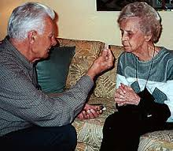
Serving as an Extraordinary Minister of Communion
to the Sick and Homebound
Notes:
Next we will look at serving as an Extraordinary Minister of Communion to the Sick and Homebound. ()

Slide 18
Vision of the Ministry
  St. Justin Martyr account in the Early Church
  Assisting the priest and deacon in reaching out to the sick
  An extension of the community’s care and love
  Connection to Sunday worship
  Also called to enrich their lives with
    News of the community
    Insights from the homily
    Greetings from other parishioners
Notes:
You’ll recall that during our first session, () we learned about St. Justin Martyr’s account of Eucharist in the early Church involved members of the community taking the Eucharist to those who were absent. ()
This ministry continues today in the Extraordinary Minister of Communion as you assist the priest and deacon in reaching out to the sick. ()
By doing so, you are also an extension of the community’s care and love to the sick and homebound, () and also their connection to the parish’s Sunday worship. ()
Through this ministry, you are also called to enrich their lives with news of the community, () insights from the homily, () and greetings from other parishioners. ()

Slide 19

Various Forms
  Communion in Ordinary Circumstances
    Longer form
    For personal homes when time allows for extended visit
  Communion in a Hospital or Institution
    Shorter form
    For visiting many rooms in a hospital or nursing home
    When comfort of the communicant calls for the shorter rite
  Viaticum outside Mass
Notes:
There are various forms of celebrating Communion of the Sick. ()
The first one is Communion in Ordinary Circumstances. () This is the longer form of the rite () that should used when visiting someone in their homes and when time allows for an extended visit. ()
The other form of the rite is Communion in a Hospital or Institution. () This is a shorter form used when you need to visit many rooms in a hospital or nursing home. () This may also be used when the comfort of the communicant calls for the shorter rite. ()
Another rite is Viaticum outside of Mass that is used for those who are dying. ()

Slide 20
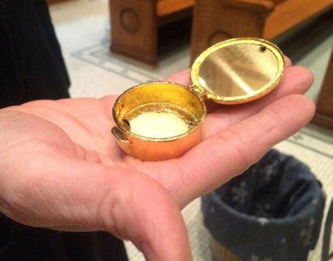
Ministry in Private Homes
  Preparations
    Call the person a day or two beforehand
        Ask how they are feeling
        Ask if they can prepare a table with a cloth, candle and crucifix
        Ask how many will be receiving (caretakers, family members)
        If visiting for the first time, ask if there are any special arrangements
          Letting yourself in
          Difficulty swallowing
          Health problems
    Have a copy of the ritual book or text of the rite to be used
      Bring your own cloth, crucifix, candle
      Bring holy water, participation aid if desired
    Bring latest copy of the parish bulletin
    Bring enough hosts in a pyx
Notes:
For ministry in private homes, there are several things you need to do to prepare for your visit. ()
First, you want to call the person a day or two beforehand. () Ask how they are feeling. () If they are well enough for a visit, ask if they can prepare a table with a cloth, candle and crucifix. () Ask them how many will be receiving, because they may have caretakers or family members in the house with them. () If you are visiting this person for the first time, you should ask them if there are any special arrangements such as letting yourself in, () if they have difficulty swallowing () or any other health problems that you should be aware of. ()
When preparing for your actual visit, have a copy of the ritual book or the text of the rite to be used. () You may want to bring your own cloth, crucifix and candle just in case. () You can even bring holy water and a participation aid if desired. () Be sure to bring the latest copy of the parish bulletin to offer them this tangible connection to the parish. () Finally, be sure to bring enough hosts in the pyx for all present to receive. ()

Slide 21
Ministry in Private Homes
  Transporting the Blessed Sacrament
    Remember focus and reverence
      Pyx should be carried on you, preferably using a burse
      Avoid placing pyx in pocket, purse or glove compartment with other items
    Go directly to the homebound person’s house
      Do not run errands, go shopping, stop for coffee etc.
      Refrain from listening to the radio or unnecessary conversation (cell phones)
Notes:
When visiting the homebound, () you will need to travel with the Blessed Sacrament, () so it is important that you keep the proper focus and reverence the entire time. ()
The pyx containing the consecrated hosts should be carried on you, preferably using a burse. () Avoid placing the pyx in a pocket, purse or glove compartment that contains other items, such a car keys, cell phone, a pack of gum, cough drops, tissues etc. ()
After you have taken the Blessed Sacrament from the tabernacle to take to the sick, go directly to the homebound person’s house. () Do not run errands, go shopping, stop for coffee, etc. () You should also refrain from listening to the radio or unnecessary conversations, especially on cell phones. ()

Slide 22
Ministry in Private Homes
  At the Home
    Initially
      Offer friendly greeting to homebound person or caregiver
      Explain what you’ve come to do
      Pay attention to how the homebound person is feeling
      Avoid socializing until after he/she has received
      Ask them to turn off the TV
    Communion Rite
      Open and place pyx on the white cloth and light candle (if not done already)
      Invite everyone to spend some time in prayer before the Blessed Sacrament
      Invite those present to participate in the prayers and readings
      Follow the ritual prescribed (next slide)
      Host may be broken into smaller pieces
      May want to keep a small glass of water nearby to assist the sick person in swallowing the host
Notes:
() Once you have arrived at the house, () offer a friendly greeting to the homebound person and caregiver. () Explain to the homebound person what you’ve come to do and pay attention to how he or she is feeling. () Avoid socializing until after he or she has received the sacrament, and politely ask them to turn off the television. ()
When you are ready to begin the Communion rite, () open and place the pyx on the white cloth and light the candle. () Invite everyone in the room to spend some time in prayer before the Blessed Sacrament. () You may even want to invite those present to participate in the prayers and readings. () Follow the ritual that is prescribed which will be presented on the next slide. () If the sick person has difficulty swallowing, the host may be broken into smaller pieces, () and you may want to keep a small glass of water nearby to help them to swallow the host. ()

Slide 23

Ministry in Private Homes
  Introductory Rites
    Greeting
    Sprinkling with Holy Water (optional)
    Penitential Rite
  Liturgy of the Word
    Reading from Scripture
    Response (silence or brief explanation)
    General Intercessions (optional)
  Liturgy of Holy Communion
    The Lord’s Prayer
    Communion
    Silent Prayer
    Prayer after Communion
  Concluding Rite
    Blessing
Notes:
Here is the outline of the Rite for Communion in the Home (Ordinary Circumstances): ()
Introductory Rites ()
Greeting ()
Sprinkling with Holy Water (optional) ()
Penitential Rite ()
Liturgy of the Word ()
Reading from Scripture ()
Response (silence or brief explanation) ()
General Intercessions (optional) ()
Liturgy of Holy Communion ()
The Lord’s Prayer ()
Communion ()
Silent Prayer ()
Prayer after Communion ()
Concluding Rite ()
Blessing
After the rite, feel free to spend some time in conversation with the homebound person. ()

Slide 24
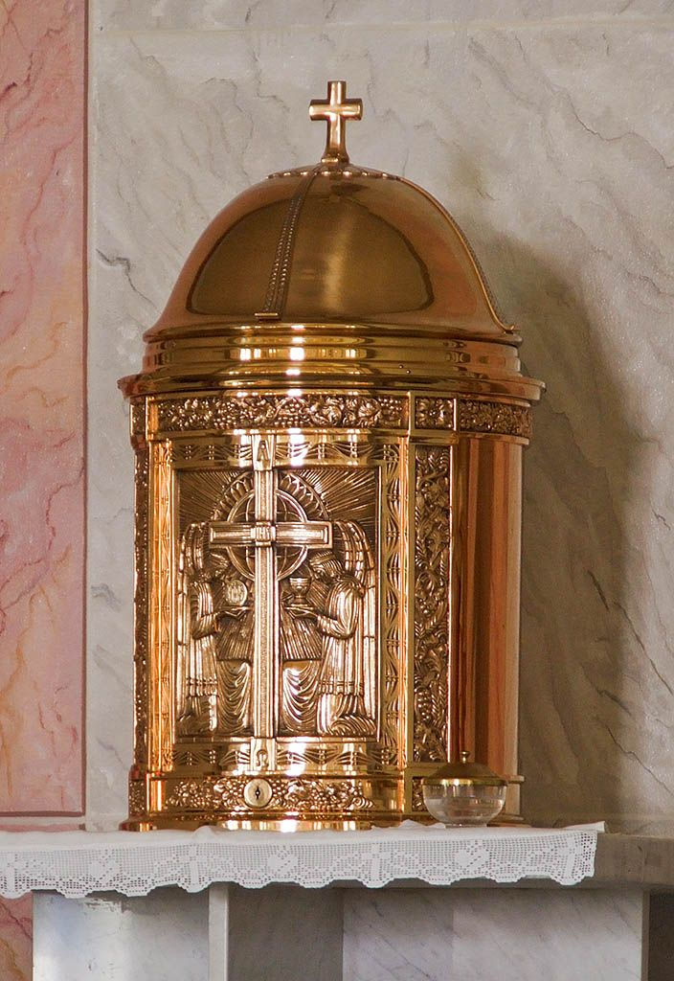
Ministry in Private Homes
  Following the Visit(s)
    Immediately return any remaining hosts to the tabernacle
    Remember reverence for the sacrament when traveling
    Purify the pyx using water and purificator
Notes:
Following the visit, () immediately return any remaining hosts to the tabernacle in church. () Again, remember reverence for the sacrament when traveling. () Purify the pyx using water and the purificator.

Slide 25
Ministry in Hospitals or Nursing Homes
  Extremely abbreviated rite
    Pastoral sensitivity should guide the adaptation of this rite
    May begin in the church, hospital chapel or the first room
      Introductory Rite
        Antiphon
      Liturgy of Holy Communion
        Greeting (optional)
        Scripture Reading (optional if there is time and seems desirable)
        The Lord’s Prayer (optional, if there are not many rooms to visit)
        Communion
      Concluding Rite (said either in the last room visited, in the church or chapel)
        Concluding Prayer
    Following the visit, return any remaining hosts to the tabernacle
      Remember reverence for the Blessed Sacrament when traveling
      Purify the pyx with water and the purificator
Notes:
For bringing Holy Communion to those in Hospitals or Nursing Homes, () there is an extremely abbreviated rite, () and pastoral sensitivity should guide the adaptation of this rite. () It may begin in the church, the hospital chapel, or the first room you are bringing Communion. ()
Introductory Rite ()
Antiphon ()
Liturgy of Holy Communion ()
Greeting (optional) ()
Scripture Reading (optional if there is time and seems desirable) ()
The Lord’s Prayer (optional, if there are not many rooms to visit) ()
Communion ()
Concluding Rite (said either in the last room visited, in the church or chapel) ()
Concluding Prayer ()
Following the visit, please return any remaining hosts to the tabernacle in church. () Again, remember reverence () and purify the pyx.
Are there any questions? After questions, continue on… ()

Slide 26
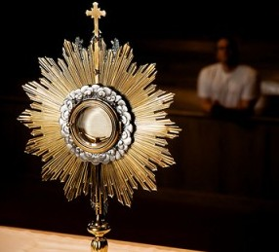
Extraordinary Minister
of
Exposition
Notes:
Next, we will look briefly at the role of Extraordinary Minister of Exposition. ()

Slide 27
Extraordinary Minister of Exposition
from Holy Communion And Worship of the Eucharist Outside Mass (91-92)
  Ordinary minister of exposition is the bishop, priest or deacon
  An Extraordinary Minister of Communion may expose and later repose the Eucharist for adoration of the faithful, but only with the explicit permission of the pastor or bishop
    May open the tabernacle
    May place the ciborium on the altar or the host in the monstrance and replace the Blessed Sacrament in the tabernacle
    Extraordinary Ministers may not give the blessing with the sacrament, nor do they incense it
    Extraordinary Ministers are to wear an alb when carrying out this ministry
Notes:
Similar to distributing Holy Communion, () the ordinary minister of exposition of the Blessed Sacrament is the bishop, priest or deacon. () An Extraordinary Minister of Communion may expose and later repose the Eucharist for adoration of the faithful, but only with the explicit permission of the pastor or bishop. ()
As part of Eucharistic Exposition, the Extraordinary Minister of Communion may open the tabernacle, () may place the ciborium on the altar or host in the monstrance () and replace the Blessed Sacrament in the tabernacle following adoration. () Extraordinary Ministers may not give the blessing with the sacrament, nor do they incense it. () Extraordinary Ministers of Exposition are to wear and alb when carrying out this ministry.
Are there any questions? After questions, continue on… ()

Slide 28
Other Points
Notes:
Here are some other points about this ministry that you should know: ()

Slide 29
Commissioning of Extraordinary Ministers of Commuion
Persons authorized to distribute Holy Communion in special circumstances should be commissioned by the diocesan bishop or his delegate according to the prescribed rite.
The commissioning should take place at a gathering of the faithful, preferably at a Sunday Mass.
Book of Blessings, Chapter 63, nos. 1871-1896.
Notes:
Extraordinary Ministers of Communion should be commissioned for their ministry. ()
According to the Book of Blessings, “Persons authorized to distribute Holy Communion in special circumstances should be commissioned by the diocesan bishop or his delegate according to the prescribed rite” (1872). ()
This commissioning should take place at a gathering of the faithful, preferably at a Sunday Mass. ()
This ritual of commissioning Extraordinary Ministers of Communion can be found in the Book of Blessings, Chapter 63, numbers 1871-1896. ()

Slide 30
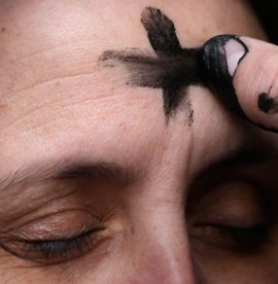
Ash Wednesday
Extraordinary Ministers of Communion may assist with the distribution of ashes
Arrive early and check in with the priest or deacon as to where you will be stationed to distribute
Check what text you’ll be saying when imposing ashes:
  “Repent, and believe in the Gospel.”
  “Remember that you are dust, and to dust you shall return.”
To impose ashes, dip your thumb into the bowl of ashes and mark each person’s forehead with the sign of the cross while saying one of the above texts.
Be sure to wash your hands thoroughly after administering the ashes.
Notes:
On Ash Wednesday, Extraordinary Ministers of Communion may be asked to assist with the Distribution of Ashes. ()
If you are asked or volunteer to do so, please arrive early and check in with the priest or deacon as to where you will be stationed to distribute () and to check what text you will be saying as you impose ashes. There are two options: () “Repent, and believe in the Gospel.” or ()“Remember that you are dust, and to dust you shall return.” ()
To impose ashes, dip your thumb into the bowl of ashes and mark each person’s forehead with the sign of the cross while saying one of the above texts. () Be sure to wash your hands thoroughly after administering the ashes. ()

Slide 31
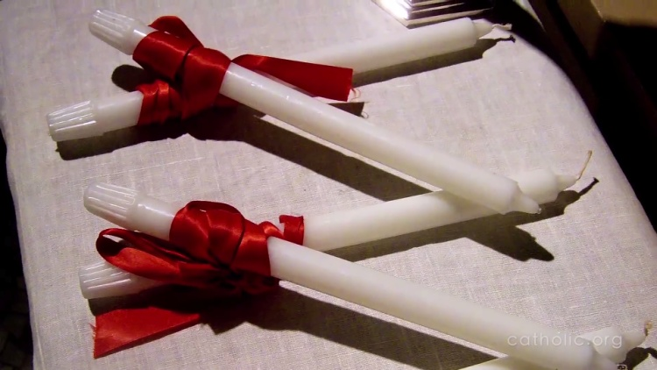
Blessing of Throats
Extraordinary Ministers of Communion may be asked to assist in the blessing of throats on the memorial of St. Blaise (Feb. 3) or the nearest weekend
Normally, crossed candles are held to the throat of the person while the following blessing is given WITHOUT making the Sign of the Cross:
“Through the intercession of St. Blaise, bishop and martyr, may God deliver you from every disease of the throat and from every other illness: In the name of the Father, and of the Son, and of the Holy Spirit. Amen.”
Notes:
On February 3rd, the Church celebrates the memorial of St. Blaise. In some churches, either on February 3rd or the nearest weekend, the throats of parishioners are blessed after Mass. ()
Extraordinary Ministers of Communion may be called upon to assist in the Blessing of Throats. ()
Extraordinary Ministers of Communion would do this by holding crossed candles to the throat of the person while saying the following blessing WITHOUT making the Sign of the Cross over the person: ()
“Through the intercession of St. Blaise, bishop and martyr,
may God deliver you from every disease of the throat
and from every other illness: In the name of the Father,
and of the Son, and of the Holy Spirit. Amen.” ()

Slide 32
Communion in Absence of a Priest
Difference between a Mass and a Service
  Communion Service
    Celebration of the Word of God
    Reception of Holy Communion
  Mass
    Liturgy of the Word
    The Eucharistic Prayer (sacrifice and memorial)
Must make a clear distinction between Mass and a Communion Service
Parishes should alert the faithful to other Masses in the area
Notes:
Finally, on rare occasions, a parish may offer a Communion Service when a priest is not available to offer Mass. () If such a service is offered, it is of utmost importance that the community be aware of the difference between a Mass and a Communion Service. ()
While both of these celebrations may appear similar in that they contain a celebration of the Word of God (Liturgy of the Word), only the sacrifice of the Mass contains the Eucharistic Prayer in which the bread and wine are consecrated to become the Body and Blood of Christ. At a Communion Service, the faithful receive the Lord’s Body in Holy Communion, but they do not participate in that great sacrifice of the Mass which is the center and high point of our lives as Catholic Christians. ()
Whenever the Rite for Distributing Holy Communion Outside Mass with a Celebration of the Word is scheduled on a weekday, every effort must be undertaken to avoid any confusion between this celebration and the Mass. Indeed, such celebrations should encourage the faithful to be present at and to participate in the celebration of the Mass. ()
Whenever possible, the Mass schedule of nearby parishes should be available to parishioners. If a nearby parish is celebrating Mass on a given weekday, serious consideration should be given to encouraging people to participate in that Mass rather than the parish scheduling a Liturgy of the Word with Distribution of Holy Communion. ()

Slide 33


Communion in Absence of a Priest
When it would be necessary
Who can preside
Sunday Celebrations in the Absence of a Priest and Holy Communion and Worship of the Eucharist outside Mass
Notes:
When the celebration of Mass is not possible, in particular on a regular basis, a Communion Service may be offered to provide an opportunity for the faithful to gather together to be strengthened and nourished by Sacred Scripture and receiving the Lord in Holy Communion. It was never the intention of the Church that a Communion Service become a common practice in a parish as a matter of convenience for the people or be viewed as a “substitute” for Mass when the priest is not available. ()
It is current policy in the Diocese of Scranton that deacons and Extraordinary Ministers of Communion having the explicit permission of the pastor can preside at a Communion Service in place of a regularly scheduled Mass, provided they adhere to the guidelines just mentioned.()
The two ritual books used for Communion Services are Sunday Celebrations in the Absence of a Priest and Holy Communion and Worship of the Eucharist outside Mass which should be found in the church sacristy.
Does anyone have any questions?
After questions, continue with the practicum.

