Slide 1
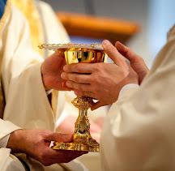
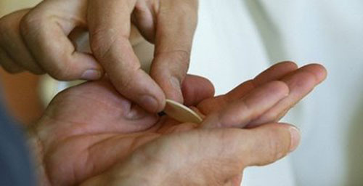
“For I received
from the Lord
what I also
handed on
to you…”
1 Corinthians 11:23
THE EXTRAORDINARY MINISTER
OF HOLY COMMUNION
Notes:
PART I
Materials needed:
Registration or Sign up sheet and pens
Microphone (if large crowd)
Computer, LCD Projector, Projection screen or bare wall
CD or computer file with Extraordinary Minister of Holy Communion Power Point Presentation
Sheet with Opening Prayer
Hymnals or worship aids
Definition of Terms handout
Reflections on Serving as an Extraordinary Minister of Communion handout
Chalice, ciboria (different types if possible), corporal and purificator for demonstration
Musician to accompany on organ/piano or lead singing a cappella
Simple refreshments for breaks (optional)
Using this resource:
The instructor should follow the script closely.
() in the script indicates a mouse click that advances the presentation to the next slide. Please note that there is no need to wait for the slide to transition. You may continue speaking since the Power Point was designed not to interrupt the flow of the presentation.
There are opportunities for prayer, group discussion, handouts and practicum throughout the 3 parts of this presentation.

Slide 2
Outline
PART I
Understanding of Ministry
Role of the Extraordinary Minister of Communion
Requirements of the Extraordinary Minister of Communion
Notes:
This formation for Extraordinary Ministers of Communion will be divided into three parts (with each session lasting approximately 2 ½ hours) and periodic breaks during the sessions: ()
In Part 1 () we will review a general understanding of ministry both in the universal Church and in our own diocese as articulated by Bishop Bambera’s Pastoral Vision, Wounded and Loved, Regathering the Scattered ()
We will also examine the role of the Extraordinary Minister of Communion, including the particular functions of the ministry and its history. ()
Finally, we will focus on the basic requirements of the Extraordinary Minister of Communion, and review definitions of items and concepts important to the ministry. ()

Slide 3
Outline
PART II
The Liturgy
The Eucharist
Understanding of the sacrament
Walk through the Mass
Theology of the Real Presence
Practicum
Notes:
In Part II, () we will examine a understanding of Liturgy in the Catholic Church, () and specifically, the celebration of the Eucharist. ()
This will include a description of the sacrament, () a walk-through of the Mass () and a brief overview of the theology of the Real Presence of Christ in the Blessed Sacrament. ()
If time allows, we will also begin the practicum of distributing Holy Communion at Mass. ()

Slide 4
Outline
PART III
Serving as an Extraordinary Minister of Communion at Mass
Serving as an Extraordinary Minister of Communion to the Sick & Homebound
Serving as an Extraordinary Minister of Exposition
Other aspects of the Ministry
Notes:
In Part III, () we will examine the procedures for serving as an Extraordinary Minister of Communion at Mass, that includes general principles and guidelines that may be adapted in your particular parish as well as potential “problems” or issues you may encounter when serving. ()
We will also examine the procedures for serving as an Extraordinary Minister of Communion to the sick and homebound. This also includes institutions such as hospitals, nursing homes, and prisons. ()
Although infrequent, you may be called upon to serve as an Extraordinary Minister of Exposition of the Blessed Sacrament, so we will review the guidelines and procedures for that occasion. ()
Finally, we will go over other aspects of the ministry that you will need to know about and then continue the practicum. ()

Slide 5
Materials Used
Power Point presentation
Handouts
Sacred Linens,Chalices, ciboria and unconsecrated hosts during practicum
Notes:
During these formation sessions, () we will be using this Power Point presentation that includes opportunities for prayer and discussion. ()
There will also be various handouts that will help further your understanding of this ministry and the terminology used. ()
During the practicum, we will make use of the sacred linens, chalices or cups, ciboria or bowls, and unconsecrated hosts. ()
You will also receive a handbook covering all of general guidelines and principles for serving as an Extraordinary Minister of Communion at Mass or to the Sick and Homebound at the conclusion of this formation.
Questions?
After questions, continue on…()

Slide 6
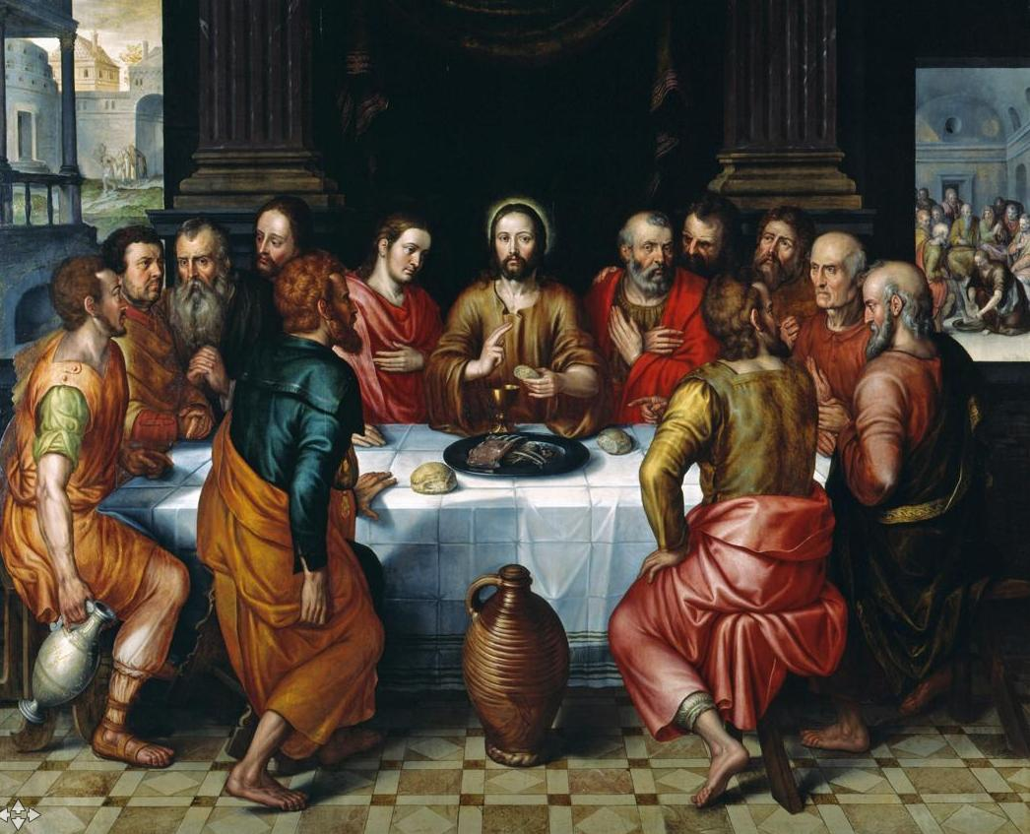
Prayer
Notes:
Let’s begin our session with prayer.
Use Extraordinary Minister of Communion Prayer 1.
Following the hymn, advanced to the next slide for the reading. ()

Slide 7
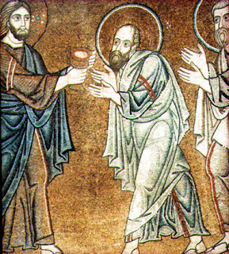
I Corinthians 11:23-26
Brothers and sisters:
I received from the Lord what I also handed on to you,
that the Lord Jesus, on the night he was handed over,
took bread, and, after he had given thanks, broke it
and said, “This is my body that is for you.
Do this in remembrance of me.”
In the same way also the cup, after supper, saying,
“This cup is the new covenant in my blood.
Do this, as often as you drink it, in remembrance of me.”
For as often as you eat this bread, and drink the cup,
you proclaim the death of the Lord until he comes.
Notes:
A reading from the first letter of Paul to the Corinthians: ()
Brothers and sisters:
I received from the Lord what I also handed on to you,
that the Lord Jesus, on the night he was handed over,
took bread, and, after he had given thanks, broke it
and said, “This is my body that is for you.
Do this in remembrance of me.”
In the same way also the cup, after supper, saying,
“This cup is the new covenant in my blood.
Do this, as often as you drink it, in remembrance of me.”
For as often as you eat this bread, and drink the cup,
you proclaim the death of the Lord until he comes.
Continue with the prayer found on the sheet.
When finished with the prayer, continue on ()

Slide 8
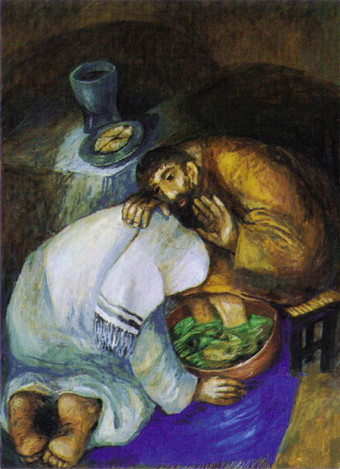
Understanding
of
Ministry
Notes:
We begin this formation session by taking a closer look at the importance of ministry in the Catholic Church. ()

Slide 9
Ministry in the Church
Baptismal Call
To serve others--“Reborn as sons of God, the baptized must participate in the apostolic and missionary activity of the People of God” (CCC 1270).
To participate in the liturgy—“The baptismal seal enables and commits Christians to serve God by a vital participation in the holy liturgy of the Church” (CCC 1273).
Notes:
Where does this understanding of ministry come from? ()
It comes, first and foremost, from our Baptism. Through Baptism, we are first called to serve others. According to the Catechism of the Catholic Church, “Reborn as sons of God, the baptized must participate in the apostolic and missionary activity of the People of God” (CCC 1270). ()
We also have an obligation to participate in the liturgy of the Church, for the Catechism goes on to say that “The baptismal seal enables and commits Christians to serve God by a vital participation in the holy liturgy of the Church” (CCC 1273). ()

Slide 10
I Corinthians 12:4-7
“There are different kinds of spiritual gifts but the same Spirit; there are different forms of service but the same Lord; there are different workings but the same God who produces all of them in everyone. To each individual the manifestation of the Spirit is given for some benefit.”
There are various ministries in liturgy
Each member is called to play a different role
Must discern our gifts and call by God to share those gifts
Notes:
St. Paul, () in his first letter to the Corinthians, tells us that “There are different kinds of spiritual gifts, but the same Spirit; there are different forms of service but the same Lord; there are different workings but the same God who produces all of them in everyone. To each individual the manifestation of the Spirit is given for some benefit” (I Cor. 12;4-7). ()
Just as there are different gifts among the members of the Body of Christ, so there are various ministries in the liturgy of the Church. ()
Each member is called to play a role in the liturgy based on his or her gifts, whether it be as the Presider, a Lector, an Extraordinary Minister of Communion, Cantor, Altar Server, Usher, Minister of Hospitality or as a member of the faithful who worship. ()
Through prayer and reflection though, we must discern the gifts we have and the call by God to share those gifts with the Church. ()

Slide 11
Ministry in the Church
Each person has been given a gift from God
GIFT
Each person is called to share that gift with the Body of Christ
NEED
Realizing our gift comes from God
HUMILITY
Notes:
Thus, () we can see that ministry in the Church comes from the belief that each person has been given a GIFT by God. ()
Each person is called to share his or her gifts with the rest of the Body of Christ because there is a genuine NEED. ()
What is essential to ministry is the realization that our gifts come from God and that we must share them with great HUMILITY. ()

Slide 12
Ministry in the Church
Definition of Ministry
from The Ministry of Music by Fr. William Bauman
“Ministry is service rendered out of love, and with a deep respect for the person served, after the model of Jesus. Ministry is never self-seeking; ministry is giving, and it is the kind of giving in which one loves the person one gives to.”
Notes:
Fr. William Bauman, a priest from Kansas City, offered an excellent definition of ministry in his book, The Ministry of Music. While written in the context of music ministry, this definition captures the essence of ministry in all areas of parish life. ()
He writes, “Ministry is service rendered out of love, and with a deep respect of the person served, after the model of Jesus. Ministry is never self-seeking; ministry is giving, and it is the kind of giving in which one loves the person one gives to.” ()

Slide 13
Ministry in the Church
Ministry is not:
Acting better or holier than another
Creating an elite in the parish
Rewarding someone
Self-gratifying performance
Ministry is:
Humility
A way of achieving our own salvation
Helping others move toward the Lord.
Notes:
From this we can deduce that ministry is not: ()
acting better or holier than another, ()
nor an effort by the pastor to create an elite in the parish ()
nor offering a reward to someone, ()
nor should it ever develop into a self-gratifying performance. ()
Instead, ministry is, ()
first and foremost, humble service, ()
a way of contributing to our own salvation (hopefully), ()
and a way to help others move closer to the Lord in their own faith. ()

Slide 14
Ministry as Servant Leadership
Wounded and Loved, Regathering the Scattered Bishop Bambera’s Pastoral Vision for the Church of Scranton
Footwashing at the Last Supper—John 13: 1-15
“We are called to lead lives deeply rooted in service—service to our God, neighbor, self, and creation” (6).
“Serving, one comes to realize that service to God and neighbor is also an act of leadership that differs in kind and orientation from what normally counts as leadership. Christian disciples lead as a result of faith, not because of personal success or institutional commitment” (6).
Notes:
In his Pastoral Vision for the Diocese of Scranton, Wounded and Loved, Regathering the Scattered, () Bishop Bambera uses the passage of the Footwashing from John’s gospel as the foundation for his vision of servant leadership. [Consider reading the passage to the candidates: John 13:1-15]
In his pastoral, Bishop Bambera tells us: ()
“We are called to lead lives deeply rooted in service—service to our God, neighbor, self, and creation” and ()
“Serving, one comes to realize that service to God and neighbor is also an act of leadership that differs in kind and orientation from what normally counts as leadership. Christian disciples lead as a result of faith, not because of personal success or institutional commitment.” ()

Slide 15
Ministry as Servant Leadership
Wounded and Loved, Regathering the Scattered Bishop Bambera’s Pastoral Vision for the Church of Scranton
One of Bishop Bambera’s goals for servant leaders who worship is “Find ways to promote: liturgical catechesis in the parish, and improved quality of participation by parishioners of all ages in Sunday Mass, the calling of men and women to liturgical ministries, the training of liturgical ministers, both spiritually and functionally, and improved use of music and art to enhance liturgical celebrations in a way that the world can comprehend” (10).
Notes:
Finally, () one of his goals for servant leaders who worship is the promotion of liturgical formation. This includes:
catechesis
improved participation at Mass
inviting and properly training men and women in liturgical ministries, both spiritually and functionally, and
the improved use of music and art to enhance liturgical celebrations. ()

Slide 16
Beginning Your Ministry
Examine how your gifts can best be shared
Take into consideration the preparation and time required
Attend theological and practical training necessary for this ministry
Be commissioned by the pastor for that particular ministry
Embrace forms of personal prayer that connect you to your particular area of service
Receive ongoing formation in that ministry
Prayer
Study
Attendance at parish or diocesan periods of reflection
Notes:
Before we can begin a ministry in the Church, () we must examine how our gifts can best be shared. For example, not everyone is gifted at singing to serve as a cantor or song leader at Mass, and not everyone is gifted with public speaking to serve as a lector at Mass. ()
We must also take into consideration the preparation and time required for the ministry. Some ministries require more preparation outside of Mass than others. ()
To be properly formed as a liturgical minister, it is necessary to attend theological and practical training such as this session. ()
It is also recommended that liturgical ministers are commissioned or blessed by the pastor for his or her liturgical ministry. ()
We are encouraged to embrace forms of personal prayer that connect us to our particular area of service, such as an Extraordinary Minister of Communion participating in Eucharistic Adoration or a Cantor reflecting on the readings of the day when preparing to sing the Responsorial Psalm. ()
Lastly, we are encouraged to receive ongoing formation in our ministry through our personal prayer, study and attendance at parish or diocesan periods of reflection. ()

Slide 17
Discussion
Why have you agreed to serve
as an Extraordinary Minister of Communion?
Notes:
Does anyone have any questions so far?
After questions, continue on…
A question for our reflection and discussion: ()
Why have you agreed to serve as an Extraordinary Minister of Communion?
After discussion, continue on… ()

Slide 18
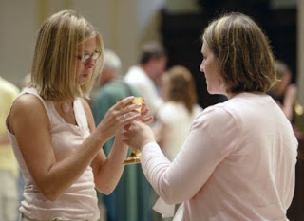
The Role
of the
Extraordinary Minister of Communion
Notes:
Next, we will examine the role of the Extraordinary Minister of Communion, including a historical overview of the ministry. ()

Slide 19
Particular Functions of the Ministry
Distribution of Communion at Mass in the absence of ordinary ministers (bishop, priest or deacon)
Taking Communion to those who are sick, homebound, in nursing homes, hospitals, or prisons
May expose and repose the Blessed Sacrament for Eucharistic Adoration
Notes:
Extraordinary Ministers of Communion are called upon to carry out the following functions in the Church: ()
To assist with the distribution of Holy Communion at Mass in the absence of ordinary ministers such as the bishop, priest or deacon. This is a very important fact that affects the terminology we use to describe this ministry. As EXTRAordinary Ministers of Communion, you are called upon to fill a need when ordinary ministers, the ordained, are not available. We generally do not use the term “Eucharistic Minister” to describe lay persons who distribute Communion. ()
Second, Extraordinary Ministers of Communion may take Communion to those who are sick, homebound, in nursing homes, hospitals or prisons when ordained clergy are not available. ()
Third, Extraordinary Ministers of Communion may expose and repose the Blessed Sacrament for Eucharistic Adoration with explicit permission of the pastor. ()

Slide 20
The Priesthood of the Laity
Baptism is the foundation of all ministry
Anointed as a member of Christ’s Body, who is priest, prophet and king
Receive the right and duty to participate in the sacramental life of the Church, especially the Eucharist
The baptized take part in the sacrifice that Christ eternally offers to God the Father through the Holy Spirit.
Notes:
As mentioned earlier, () the sacrament of Baptism is the foundation of all ministry in the Church. ()
Through this sacrament, we were anointed with Sacred Chrism to be a member of Christ’s Body, who is priest, prophet and king, () and we received the right and duty to participate in the sacramental life of the Church, especially the Eucharist. ()
Sharing in that priesthood, we have an obligation then, to take part in the sacrifice that Christ eternally offers to God the Father through the Spirit in the sacred liturgy. ()

Slide 21
The Body of Christ
“Whoever eats my flesh and drinks my blood remains in me and I in him. Just as the living Father sent me and I have life because of the Father, so also the one who feeds on me will have life in me” (John 6:56-57).
“I am the vine, you are the branches. Whoever remains in me and I in him will bear much fruit” (John 15:5).”
Expressive of our identity as many, but one united in Christ
Theology of St. Paul (I Corinthians 12)
Many members, but one faith
Many gifts, but one Spirit that distributes these gifts to build up the Body of Christ
Notes:
Through Baptism, we also became members of the Body of Christ, the Church. The words of Jesus in John’s gospel provide deep insight as to what being a member of his Body means: ()
“Whoever eats my flesh and drinks my blood remains in me and I in him. Just as the living Father sent me and I have life because of the Father, so also the one who feeds on me will have life in me” (John 6:56-57) ()
And also,
“I am the vine, you are the branches. Whoever remains in me and I in him will bear much fruit” (John 15:5). () This is expressive of our identity as many, but one united in Christ. ()
St. Paul also expresses this theology in his first letter to the Corinthians, Chapter 12 () when he talks about many members, but one faith, () and many gifts, but one Spirit that distributes these gifts to help build the Body of Christ. ()

Slide 22
The Body of Christ
Historical Body of Christ—Jesus Christ, both human & divine
Sacramental Body of Christ—the consecrated bread and wine we receive at Eucharist
Ecclesial Body of Christ—those baptized into Christ Jesus; the Catholic Church
The Eucharist is our connection to Christ and to each other, as well as our call to serve the world.
Notes:
While we have be focusing on the “Body of Christ” in reference to the universal Church (Christ as the head and we, the members), it can be confusing because we have multiple definitions for this term. However, we will see how all the meanings of this term are intimately connected. ()
First, we refer to the historical Body of Christ: Jesus Christ, both human and divine, God incarnate, who walked the earth two thousand years ago. ()
Second, we refer to the sacramental Body of Christ: the consecrated bread and wine that we receive at Eucharist. ()
Third, we refer to the ecclesial Body of Christ: those baptized into Christ Jesus in the Catholic faith. ()
These three aspects put together express the fundamental truth of our Catholic faith: that the Eucharist (sacramental) is our union with Christ (historical) and to each other, as well as our call to serve the world (ecclesial). ()

Slide 23
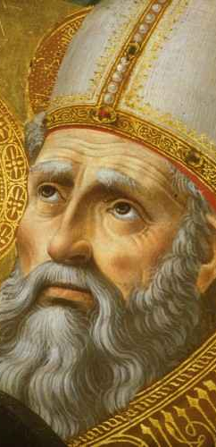
St. Augustine
You Are What You Eat
“What you see…is bread and a cup. This is what your eyes report to you. But your faith has need to be taught that the bread is the body of Christ, the cup the blood of Christ…If then, you wish to understand the body of Christ, listen to the Apostle as he says to the faithful, “You are the body of Christ and His members”…You reply “Amen” to that which you are, and by replying you consent… Be a member of the body of Christ so that your ‘Amen’ may be true… Be what you see, and receive what you are” (Sermon 272).
Notes:
St. Augustine, in one of his ancient homilies, expresses this tenet of our faith beautifully. () While he doesn’t entitle his homily, “You Are What You Eat,” this modern phrase does sum up exactly what he is getting at. St. Augustine writes, ()
“What you see…is bread and a cup. This is what your eyes report to you. But your faith has need to be taught that the bread is the body of Christ, the cup the blood of Christ…If then, you wish to understand the body of Christ, listen to the Apostle as he says to the faithful, ‘You are the body of Christ and his members’…You reply ‘Amen’ to that which you are, and by replying you consent…Be a member of the body of Christ so that your ‘Amen’ may be true…Be what you see, and receive what you are” (Sermon 272).
We can see, then, how the sacrament we receive, the Body of Christ, is also our identity and our purpose. ()

Slide 24
Discussion
How does your parish affirm this important insight that “we become what we receive”?
Notes:
Another question for our reflection and discussion: ()
How does your parish affirm this important insight that “we become what we receive”?
After discussion, continue on… ()

Slide 25
History of the Ministry
Eucharist in the Early Church
Jewish meal traditions of blessing God at the breaking of the bread is the context in which specific Christian rituals emerged
Not confined to a certain building, but any sheltered place where the community could gather around a table
The Greek term ekklesia or “Church” did not refer to a building but to believers
No separate understanding of Eucharist and the whole Christian way of life
Notes:
Next, we will look at a brief history of the Extraordinary Minister of Communion, () starting with Eucharist in the early days of Christianity. ()
In the Early Church, Jewish meal traditions of blessing God at the breaking of the bread is the context in which specific Christian rituals gradually emerged. ()
Eucharist during this time was not confined to a certain building like we have today, but any sheltered place were the local Christian community could gather around a table. ()
In fact, during this period the Greek term, ekklesia or “church” did not refer to a building, but to the believers. ()
And there was no separate understanding of Eucharist, or the Body of Christ, and the whole Christian way of life. ()

Slide 26
History of the Ministry
Eucharist in the Early Church
When the Church gathered, members did not feel complete if anyone is missing.
Anyone missing was remembered in prayer
Family members or others would take the Eucharist from the gathering to those who were absent
Taking part in Christian worship was grounds for arrest, imprisonment, torture or execution
Taking Eucharist to those absent carried the same consequences
Notes:
The community of believers, or the Church, was so closely united, () that when they gathered, members did not feel complete if anyone was missing. ()
Those who were missing were remembered in prayer () and family members would take the Eucharist from the gathering to those who were absent.
This was not simply a gesture of hospitality, but a genuine act of great courage and faith () since taking part in Christian worship at that time was illegal and grounds for arrest, imprisonment, torture or execution ()
Taking the Eucharist to those absent carried the same consequences. ()

Slide 27
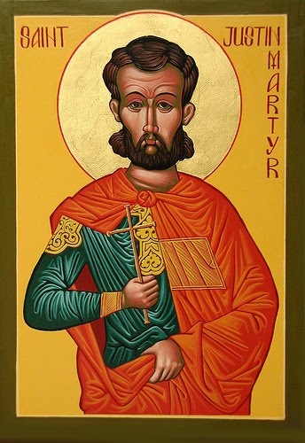
Early Description of Eucharist
St. Justin Martyr (d. ca. 165); First Apology
“The records of the apostles or writings of the prophets are read for as long as time allows. Then, when the reader has finished, the president in a discourse admonishes [us] to imitate these good things. Then we all stand up together and offer prayers; and as we said before, when we have finished praying, bread and wine and water are brought up, and the president likewise offers prayers and thanksgiving to the best of his ability, and the people assent, saying the Amen; and there is a distribution, and everyone participates in [the elements] over which thanks have been given; and they are sent through the deacons to those who are not present” (67:3-5).
Notes:
One of the earliest descriptions of the celebration of the Eucharist comes from St. Justin Martyr, () who died around the year 165. In his First Apology he writes, ()
“The records of the apostles or writings of the prophets are read for as long as time allows. Then, when the reader has finished, the president in a discourse admonishes [us] to imitate these good things. Then we all stand up together and offer prayers; and as we said before, when we have finished praying, bread and wine and water are brought up, and the president likewise offers prayers and thanksgiving to the best of his ability, and the people assent, saying the Amen; and there is a distribution, and everyone participates in [the elements] over which thanks have been given; and they are sent through the deacons to those who are not present” (67:3-5). ()

Slide 28
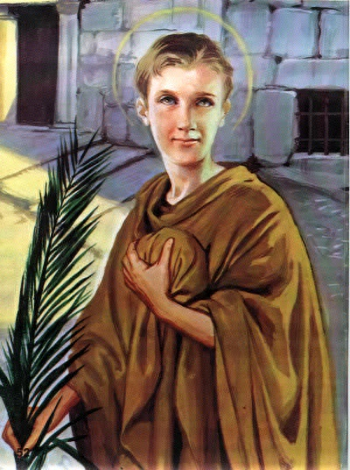
St. Tarcisius
3rd Century martyr
An acolyte or deacon
Was taking the Eucharist to the sick or prisoners when a mob of unbelievers confronted him and asked him what he was carrying.
He refused to hand over the Eucharist to them, so they beat him to death
Patron saint of altar servers and a martyr for the Eucharist
Notes:
One example that we have of someone taking the Eucharist to someone else is St. Tarcisius. () He was a 3rd Century martyr () who was believed to be an acolyte or deacon in the Early Church. () He was taking the Eucharist to the sick or prisoners when a mob of unbelievers confronted him and asked him what he was carrying. () He refused to hand over the Eucharist to him, so they beat him to death. () Today he is considered the patron saint of altar servers and a martyr for the Eucharist. Extraordinary Ministers of Communion may even consider him as their patron saint, since he knew the depth of his ministry. ()

Slide 29
History of the Ministry
Growth of Christianity in the Roman Empire
Constantine legalized Christianity in 313
Theodosius I made Christianity the official religion of the Roman Empire in 380
Christianity flourished but led to changes in worship
Notes:
In spite of persecution, the number of faithful Christians grew. ()
After the Roman Emperor Constantine legalized Christianity in 313 () and Emperor Theodosius made Christianity the official religion of the Roman Empire in 380, () the number of Christians began to grow rapidly. This led to some changes in Christian worship. ()

Slide 30
History of the Ministry
Middle Ages
Deacons were considered as the “extraordinary” ministers of Communion
Concept of Eucharist as a “meal” is lost, More emphasis on the Eucharist as a sacrifice
Separation between priests and laity in worship
Active participation becomes passive
Communion received infrequently
Notes:
By the Middle Ages, () deacons became the “extraordinary” ministers of Communion with bishops and priests being the ordinary ministers.()
The concept of Eucharist as a sacred meal is lost, and more emphasis was placed on the sacrificial aspect of the Eucharist. ()
Because of this greater understanding of Eucharist as a sacrifice, a separation developed between the priests and laity during worship. ()
Active participation during the celebration of the Eucharist began to decline leading to a more passive participation such as personal devotions being prayed while the priest offered the sacrifice of the Mass.
A greater sense of unworthiness among the faithful also led to infrequent reception of Communion. ()

Slide 31
History of the Ministry
St. Thomas Aquinas
doctrine of transubstantiation
the “accidents” (visible reality) of bread and wine remain, but the “substance” is changed into Christ’s Body and Blood.
Has become the Catholic understanding of “Real Presence” of Christ in the Eucharist
Notes:
It was also during this time period that St. Thomas Aquinas, a Dominican, () posed the doctrine of transubstantiation. ()
Using the philosophy of Aristotle, St. Thomas explains that in the Eucharist, the “accidents” or visible reality of bread and wine remain, but the “substance” is changed into Christ’s Body and Blood. ()
This teaching has become the Catholic Church’s understanding of the “Real Presence” of Christ in the Eucharist to this day. We’ll examine this doctrine more in depth later. ()

Slide 32
History of the Ministry
Pope Saint Pius X (1835-1914)
Called for active participation of people at Mass
Promoted more frequent reception of Communion and Confession
Lowered the age for the reception of Communion to 7 (age of reason).
Bringing children to receive from the altar led to the regular reception of Communion by parents and grandparents, thus the practice caught on.
Notes:
Skipping ahead several hundred years, () Pope Saint Pius X in the early 20th century, attempted to reverse some of the changes in the celebration of the Eucharist in the Middle Ages. ()
He called for a greater and more active participation of people at Mass. ()
He promoted more frequent reception of Holy Communion and going to confession. ()
He also lowered the age for the reception of Communion to 7, or the age of reason. ()
Bringing children to receive Communion led to the regular reception of Communion by parents and grandparents, thus the practice of receiving more frequently caught on. ()

Slide 33
History of the Ministry
Second Vatican Council (1962-1965)
Return to the understanding of Eucharist as a meal and sacrifice
Looking at Eucharist both vertically and horizontally
Restored deacons as “ordinary” ministers of Communion
Encouraged the faithful to receive Communion more
Renewed sense of ritual and structure of the Mass
Full, conscious and active participation of the assembly
Increased liturgical roles of the laity
Notes:
The Second Vatican Council in the early 1960s () returned to the Early Church’s understanding of the Eucharist both as a sacred meal and sacrifice. ()
This allowed the faithful to view the Eucharist both vertically, as our sacrifice to God, and horizontally, expressive of our identity as the Body of Christ. ()
The Council also restored deacons as the “ordinary” ministers of Communion () and encouraged the faithful to receive Communion more. ()
Last, but certainly not least, the Second Vatican Council also provided a renewed sense of ritual and structure of the Mass, () that included the full, conscious and active participation of the assembly, () as well as increased liturgical roles for the laity. ()

Slide 34
History of the Ministry
Memoriale Domini (1969)
Document that gave permission for the faithful to return to the practice of receiving Communion in the hand
St. Cyril of Jerusalem (ca. 313-386): “Make your left hand a throne for your right, because your right is going to receive the King; make a hollow of your palm and receive the body of Christ, saying after it: ‘Amen!”…Then, after you have partaken of the body of Christ, come forward to the chalice of His blood…”
Notes:
One of the documents that followed the Second Vatican Council was Memoriale Domini in 1969 () that gave permission for the faithful to return to the practice of receiving Holy Communion in the hand. ()
Writing in the Fourth Century, St. Cyril of Jerusalem refers to receiving Communion in the hand when he instructs, “Make your left hand a throne for your right, because your right is going to receive the King; make a hollow of your palm and receive the body of Christ, saying after it: ‘Amen!”…Then, after you have partaken of the body of Christ, come forward to the chalice of His blood…”()

Slide 35
History of the Ministry
Fidei custos (1969) and Immensae Caritas (1973)
Allowed the diocesan bishop to designate lay people as extraordinary ministers to assist with the distribution of Communion
Outside of Mass when an ordinary minister is not available, especially as Viaticum to the sick and those in danger of death
Usual minister is impeded by poor health, advanced age, or demands of pastoral ministry
When the number of faithful wishing to receive Communion is so great that it would unduly prolong the liturgy
Extraordinary ministers of Communion “should be outstanding in Christian life, in faith, and in morals” (FC 5).
Notes:
Two other Church documents (), Fidei custos in 1969 and Immensae Caritas in 1973 () allowed the diocesan bishop to designate lay people as extraordinary ministers to assist with the distribution of Communion in certain circumstances: ()
First, outside of Mass when an ordinary minister is not available, especially to the sick and as Viaticum, or “food for the journey” to those who are in danger of death. ()
Secondly, when the usual minister of Communion, that is, a bishop, priest or deacon, is impeded by poor health, advanced age or demands of their ministry. ()
Thirdly, at those Masses when the number of faithful wishing to receive Communion is so great that only having the ordinary ministers of Communion (bishop, priest or deacon) distribute would unduly prolong the liturgy. ()
Anyone designated for this extraordinary ministry, however, should be outstanding in Christian life, in faith, and morals as stated in Fidei custos. ()

Slide 36
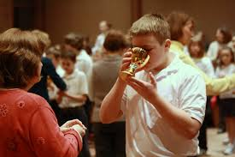
History of the Ministry
Example of a ministry born out of necessity
Great need today because of a shortage of priests and deacons
Notes:
Thus, after looking at the history of the reception of Holy Communion at Mass, we can see that the Extraordinary Minister of Communion is an example of a ministry born out of necessity. () While this ministry began over 40 years ago in the Church, it is greatly needed today because of a shortage of priests in our parishes. ()

Slide 37
Deputed by the Bishop and Pastor
Bishops, priests and deacons are the “ordinary” ministers by virtue of their ordination
Extraordinary ministers typically not used at Masses with many concelebrants (Confirmations, Chrism Mass etc.)
Don’t be offended if “bumped” from service because of the presence of a deacon or a concelebrating priest
Notes:
In summary, Extraordinary Ministers of Communion are deputed by the bishop and the pastor. ()
Remember that bishops, priests and deacons are the ordinary ministers of Communion by virtue of their ordination. () For that reason, you typically wouldn’t need Extraordinary Ministers of Communion at Masses where there are many priest concelebrants, such as Confirmations or the Mass of Chrism. ()
If you are scheduled as an Extraordinary Minister of Communion at Mass, and guest priest shows up to concelebrate, don’t be offended if you get “bumped” from serving at that Mass. By virtue of his ordination, the priest is supposed to distribute Communion. The same is true for deacons. ()

Slide 38
Deputed by the Bishop and Pastor
Supplementing and filling a need that arises
Deputed for a particular parish, not the entire diocese or other areas
Collaborate with the pastor
Assist in the smooth and reverent distribution of Holy Communion
If needed, a priest can commission someone to serve as an Extraordinary Minister of Communion on the spot using the ritual provided in the Roman Missal
Notes:
Extraordinary Ministers of Communion are supplementing and filling a need that arises. ()
They are also deputed for a particular parish, and not the entire diocese or other areas (), and Extraordinary Ministers of Communion collaborate with the pastor or priest () in assisting with the smooth and reverent distribution of Holy Communion, both within and outside Mass. ()
If needed, a priest can commission someone to serve as an Extraordinary Minister of Communion on the spot using the ritual provided in the Roman Missal. ()

Slide 39
Discussion
Who are your models for this ministry?
Whom have you seen perform this ministry well?
What have you noticed about their lives?
Notes:
Some additional questions for our reflection and discussion: ()
Who are your models for this ministry?
Whom have you seen perform this ministry well?
What have you noticed about their lives?
After discussion, continue on… ()

Slide 40
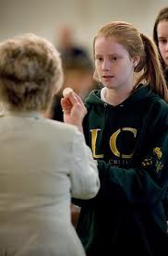
Requirements of Extraordinary Ministers of Communion
Notes:
Next, we will examine the requirements to serve as an Extraordinary Minister of Communion. ()

Slide 41
Basic Requirements
Pastors should invite parishioners to this ministry or candidates should have the recommendation of their pastor
Must be at least18 years of age
Must be a fully initiated Catholic in good standing
Must be registered and active members of the parish
If married, must be in a valid marriage.
Life must be led according to the values and morals of the Catholic Church
Notes:
Basic requirements to serve as an Extraordinary Minister include: ()
Being invited by the pastor or have the recommendation of the pastor to serve in this ministry ()
Be at least 18 years of age to serve in a parish or in campus ministry. ()
Candidates must be a fully initiated Catholic in good standing in the Church ()
Must be a registered and active member of the parish ()
If married, he or she must be in a valid marriage ()
And his or her life must be led according to the values and morals of the Church ()

Slide 42
Living the Sacramental Life
Goal is individuals whose exemplary Catholic life and morals reflect well upon the Catholic Church (Fidei custos #5)
Spiritual attributes needed or be willing to develop:
Humility
Radical hospitality
Gratitude
Reverence—both to the Eucharistic elements and the ecclesial Body of Christ
Avoiding:
Grave sin
failure to attend Mass
A choice not to maintain communion with the teachings of the Church
Notes:
As envisioned by the instruction, Fidei custos, the goal when recommending individuals to serve in this ministry is to look for those whose exemplary Catholic life and morals reflect well upon the Catholic Church. ()
Living a sacramental life, then, requires certain spiritual attributes or the willingness to develop these attributes, () such as embodying a spirit of humility, () a sense of radical hospitality for those whom you serve, () gratitude, () and reverence for both the sacramental Body of Christ and the ecclesial Body of Christ, the Church. ()
In addition to developing these spiritual attributes, an Extraordinary Minister of Communion should also avoid grave sin, () missing Mass, () and not maintaining communion with the teachings of the Catholic Church. ()

Slide 43
Living the Sacramental Life
Take advantage of the Sacrament of Reconciliation
Not just about fulfilling a function on Sunday morning, but sharing the very life of the Body of Christ
You are called to help feed those who come to the Sacred Banquet
Notes:
An important part of living out this sacramental life is taking advantage of the Sacrament of Reconciliation. Going to confession is a great way of keeping us centered in God that results in a spirit of humility, gratitude and respect for others. ()
Remember, serving as an Extraordinary Minister of Communion is not simply about fulfilling a function on Sunday morning but sharing the very life of the Body of Christ. () As part of this ministry, we care called to help feed those who come to the Sacred Banquet, as well as those who are unable to join us because of physical limitations. ()

Slide 44
Real Presence
Extraordinary Ministers of Communion need a firm understanding of the Real Presence in the consecrated bread and wine
Have a recent education in the Church’s teaching on this mystery
Be able to articulate to others the Church’s teaching on the Real Presence
Notes:
In addition to the basic and spiritual requirements, Extraordinary Ministers of Communion need a firm understanding of the Real Presence of Christ in the consecrated bread and wine we receive at Mass. ()
It would be beneficial to have a recent education in the Church’s teaching on this mystery, and, as bearers of the Eucharist, () Extraordinary Ministers of Communion must be able to articulate to others the Church’s teaching on the Real Presence. ()

Slide 45
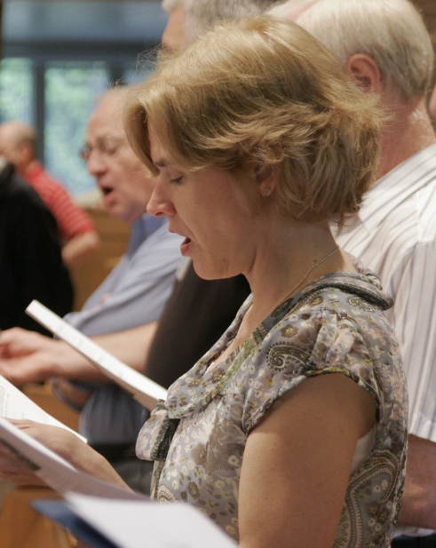
Participation in the Liturgy
Participate fully in the Mass
Attentive listening
Singing hymns and acclamations
Making responses confidently
Engaging in silent prayer
Focused on the sacred action
Understand liturgical gestures and postures that convey reverence for the Blessed Sacrament
Have the ability to move from where you are seated to the sanctuary, and then to the area of service
Have the ability to handle the plate (paten), consecrated host, the chalice and the purificator securely and reverently
Notes:
As an Extraordinary Minister of Communion you should be setting an example to the rest of the church community of full, conscious and active participation at Mass. () This includes attentive listening to the Word of God proclaimed and the prayers said aloud, singing the hymns and acclamations, making responses confidently, engaging in silent prayer, and focused on the sacred action of the Mass. ()
It is also important to understand the different gestures and postures that convey reverence for the Blessed Sacrament. The proper form of reverence for the Blessed Sacrament is genuflecting; the proper form of reverence for the altar is bowing. If an individual is physically unable to genuflect, bowing is also acceptable. ()
Extraordinary Ministers of Communion at Mass must also be able to move from where they are seated in church to the sanctuary and then to the area of service, () as well as having the ability to handle the ciborium or paten, consecrated host, chalice and purificator securely and reverently. ()

Slide 46
Ongoing Prayer and Formation
Develop your own person spirituality
Spiritual reading, especially on the Eucharist
Popular and personal devotions
Allow time for quiet and reflection
Offer prayers outside of Mass for the community or parish you serve
Participate in ongoing and communal formation for your ministry
Notes:
Finally, you are encouraged to develop and deepen your own personal spirituality as part of your liturgical ministry () that includes spiritual reading, especially on the Eucharist () and popular and personal devotions, perhaps to a saint that had a strong devotion to the Eucharist. () You also want to allow personal time for quiet and reflection.
During your personal prayer, () offer prayers for the community or parish that you serve, because you are serving the very Body of Christ in this ministry. ()
And, as mentioned before, look for opportunities to participate in ongoing and communal formation for your ministry either in your parish or through the diocese. ()
Are there any questions?
After questions, continue on…
Distribute handouts on Extraordinary Minister of Communion Definition of Terms, and highlight some of the more important terms for this ministry, such as alb, celiac sprue, chalice, ciborium, corporal, credence table, paten, purificator, pyx, species, tabernacle etc.
[END OF PART I]

