Slide 1


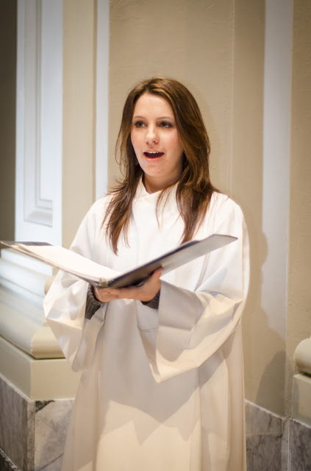
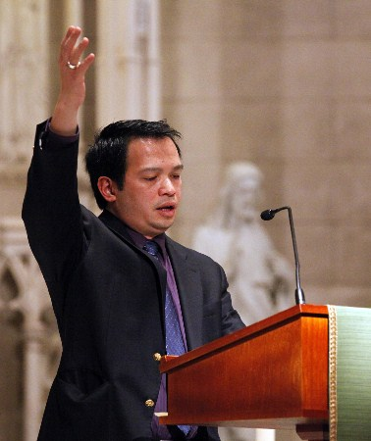
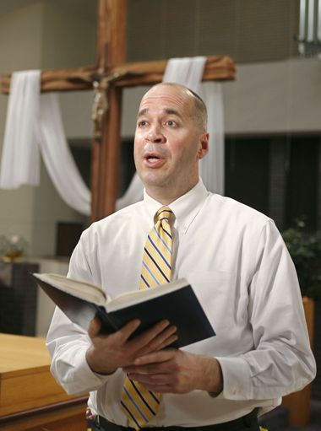
THE MINISTRY OF CANTOR
Notes:
Materials needed:
Registration or Sign up sheet and pens
Microphone (if large crowd)
Computer, LCD Projector, Projection screen or bare wall
CD with The Ministry of Cantor Power Point Presentation
Sheets with Opening Prayer
Hymnals or worship aids
Definition of Terms handout
Resources for Cantor handout
Musician to accompany on organ/piano or lead singing a cappella
Simple refreshments for breaks (optional)
Using this resource:
The instructor should follow the script closely.
() in the script indicates a mouse click that advances the presentation to the next slide. Please note that there is no need to wait for the slide to transition. You may continue speaking since the Power Point was designed not to interrupt the flow of the presentation.
There are opportunities for prayer, group discussion, and handouts throughout this presentation.

Slide 2
The Ministry of Cantor
OUTLINE
Ministry in the Church
Role of the Cantor
  Why do we sing at Mass?
  Basic requirements of the ministry
  History of the Ministry
The Liturgy
  The Eucharist
  Music in the Mass
Serving as a Cantor at Mass
Practicum
Notes:
This formation for Cantors will follow a five part outline covering various topics important to this ministry. ()
In section 1, () we will review a general understanding of ministry both in the universal Church and in our own diocese as articulated by Bishop Bambera’s Pastoral Vision, Wounded and Loved, Regathering the Scattered ()
In section 2, we will also examine the role of the Cantor, () answering the question, “Why do we sing at Mass?” () and highlighting the basic requirements of the ministry. () Next, we will take a brief look at the history of this ministry in the Church, () followed by a discussion on the Sacred Liturgy, () looking specifically at the celebration of the Eucharist () and the music sung within the Mass. ()
In section 4, we will then examine the procedures and principles for serving as a cantor at Mass, () and this formation should conclude in your parish working with your organist, accompanist or Director of Music for the practicum component of this formation process. ()

Slide 3
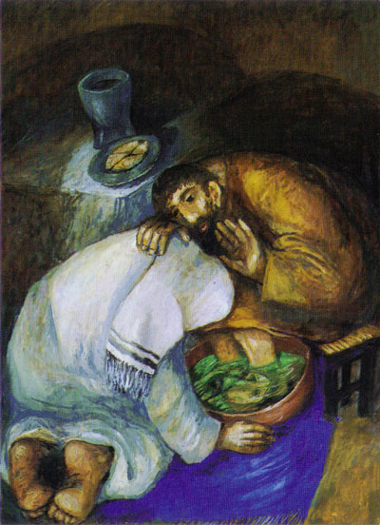
Understanding
of
Ministry
Notes:
We begin this formation session by taking a closer look at the importance of ministry in the Catholic Church. ()

Slide 4
Ministry in the Church
  Baptismal Call
    To serve others--“Reborn as sons of God, the baptized must participate in the apostolic and missionary activity of the People of God” (CCC 1270).
    To participate in the liturgy—“The baptismal seal enables and commits Christians to serve God by a vital participation in the holy liturgy of the Church” (CCC 1273).
Notes:
Where does this understanding of ministry come from? ()
It comes, first and foremost, from our Baptism. Through Baptism, we are first called to serve others. According to the Catechism of the Catholic Church, “Reborn as sons of God, the baptized must participate in the apostolic and missionary activity of the People of God” (CCC 1270). ()
We also have an obligation to participate in the liturgy of the Church, for the Catechism goes on to say that “The baptismal seal enables and commits Christians to serve God by a vital participation in the holy liturgy of the Church” (CCC 1273). ()

Slide 5
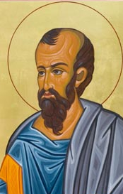
I Corinthians 12:4-7
“There are different kinds of spiritual gifts but the same Spirit; there are different forms of service but the same Lord; there are different workings but the same God who produces all of them in everyone. To each individual the manifestation of the Spirit is given for some benefit.”
There are various ministries in liturgy
Each member is called to play a different role
Must discern our gifts and call by God to share those gifts
Notes:
St. Paul, () in his first letter to the Corinthians, tells us that “There are different kinds of spiritual gifts, but the same Spirit; there are different forms of service but the same Lord; there are different workings but the same God who produces all of them in everyone. To each individual the manifestation of the Spirit is given for some benefit” (I Cor. 12;4-7). ()
Just as there are different gifts among the members of the Body of Christ, so there are various ministries in the liturgy of the Church. ()
Each member is called to play a role in the liturgy based on his or her gifts, whether it be as the Presider, a Lector, an Extraordinary Minister of Communion, Cantor, Altar Server, Usher, Minister of Hospitality or as a member of the faithful who worship. ()
Through prayer and reflection though, we must discern the gifts we have and the call by God to share those gifts with the Church. ()

Slide 6
Ministry in the Church
    Each person has been given a gift from God
    GIFT
    Each person is called to share that gift with the Body of Christ
    NEED
    Realizing our gift comes from God
    HUMILITY
Notes:
Thus, () we can see that ministry in the Church comes from the belief that each person has been given a GIFT by God. ()
Each person is called to share his or her gifts with the rest of the Body of Christ because there is a genuine NEED. ()
What is essential to ministry is the realization that our gifts come from God and that we must share them with great HUMILITY. ()

Slide 7
Ministry in the Church
  Definition of Ministry
  from The Ministry of Music by Fr. William Bauman
    “Ministry is service rendered out of love, and with a deep respect for the person served, after the model of Jesus. Ministry is never self-seeking; ministry is giving, and it is the kind of giving in which one loves the person one gives to.”
Notes:
Fr. William Bauman, a priest from Kansas City, offered an excellent definition of ministry in his book, The Ministry of Music. While written in the context of music ministry, this definition captures the essence of ministry in all areas of parish life. ()
He writes, “Ministry is service rendered out of love, and with a deep respect of the person served, after the model of Jesus. Ministry is never self-seeking; ministry is giving, and it is the kind of giving in which one loves the person one gives to.” ()

Slide 8
Ministry in the Church
    Ministry is not:
      Acting better or holier than another
      Creating an elite in the parish
      Rewarding someone
      Self-gratifying performance
    Ministry is:
      Humility
      A way of achieving our own salvation
      Helping others move toward the Lord.
Notes:
From this we can deduce that ministry is not: ()
acting better or holier than another, ()
or an effort by the pastor to create an elite in the parish ()
or offering a reward to someone, ()
nor should it ever develop into a self-gratifying performance. ()
Instead, ministry is, ()
first and foremost, humble service, ()
a way of achieving our own salvation (hopefully), ()
and a way to help others move closer to the Lord in their own faith. ()

Slide 9
Ministry as Servant Leadership
Wounded and Loved, Regathering the Scattered
Bishop Bambera’s Pastoral Vision for the Church of Scranton
  Footwashing at the Last Supper—John 13: 1-15
  “We are called to lead lives deeply rooted in service—service to our God, neighbor, self, and creation” (6).
  “Serving, one comes to realize that service to God and neighbor is also an act of leadership that differs in kind and orientation from what normally counts as leadership. Christian disciples lead as a result of faith, not because of personal success or institutional commitment” (6).
Notes:
In his Pastoral Vision for the Diocese of Scranton, Wounded and Loved, Regathering the Scattered, () Bishop Bambera uses the passage of the Footwashing from John’s gospel as the foundation for his vision of servant leadership. [Consider reading the passage to the candidates: John 13:1-15]
In his pastoral, Bishop Bambera tells us: ()
“We are called to lead lives deeply rooted in service—service to our God, neighbor, self, and creation” and ()
“Serving, one comes to realize that service to God and neighbor is also an act of leadership that differs in kind and orientation from what normally counts as leadership. Christian disciples lead as a result of faith, not because of personal success or institutional commitment.” ()

Slide 10
Ministry as Servant Leadership
Wounded and Loved, Regathering the Scattered
Bishop Bambera’s Pastoral Vision for the Church of Scranton
  One of Bishop Bambera’s goals for servant leaders who worship is “Find ways to promote: liturgical catechesis in the parish, and improved quality of participation by parishioners of all ages in Sunday Mass, the calling of men and women to liturgical ministries, the training of liturgical ministers, both spiritually and functionally, and improved use of music and art to enhance liturgical celebrations in a way that the world can comprehend” (10).
Notes:
Finally, () one of his goals for servant leaders who worship is the promotion of liturgical formation. This includes:
catechesis
improved participation at Mass
inviting and properly training men and women in liturgical ministries, both spiritually and functionally, and
the improved use of music and art to enhance liturgical celebrations. ()

Slide 11
Beginning Your Ministry
Examine how your gifts can best be shared
Take into consideration the preparation and time required
Attend theological and practical training necessary for this ministry
Be commissioned by the pastor for that particular ministry
Embrace forms of personal prayer that connect you to your particular area of service
Receive ongoing formation in that ministry
  Prayer
  Study
  Attendance at parish or diocesan periods of reflection
Notes:
Before we can begin a ministry in the Church, () we must examine how our gifts can best be shared. For example, not everyone is gifted at singing to serve as a cantor or song leader at Mass, and not everyone is gifted with public speaking to serve as a lector at Mass. ()
We must also take into consideration the preparation and time required for the ministry. Some ministries require more preparation outside of Mass than others. ()
To be properly formed as a liturgical minister, it is necessary to attend theological and practical training such as this session. ()
It is also recommended that liturgical ministers are commissioned or blessed by the pastor for his or her liturgical ministry. ()
We are encouraged to embrace forms of personal prayer that connect us to our particular area of service, such as an Extraordinary Minister of Communion participating in Eucharistic Adoration or a Cantor reflecting on the readings of the day when preparing to sing the Responsorial Psalm. ()
Lastly, we are encouraged to receive ongoing formation in our ministry through our personal prayer, study and attendance at parish or diocesan periods of reflection. ()

Slide 12
Discussion
Why have you agreed to serve
as a cantor in your parish or community?
Notes:
Does anyone have any questions so far?
After questions, continue on…
A question for our reflection and discussion: ()
Why have you agreed to serve as an Cantor in your parish or community?
After discussion, continue on… ()

Slide 13
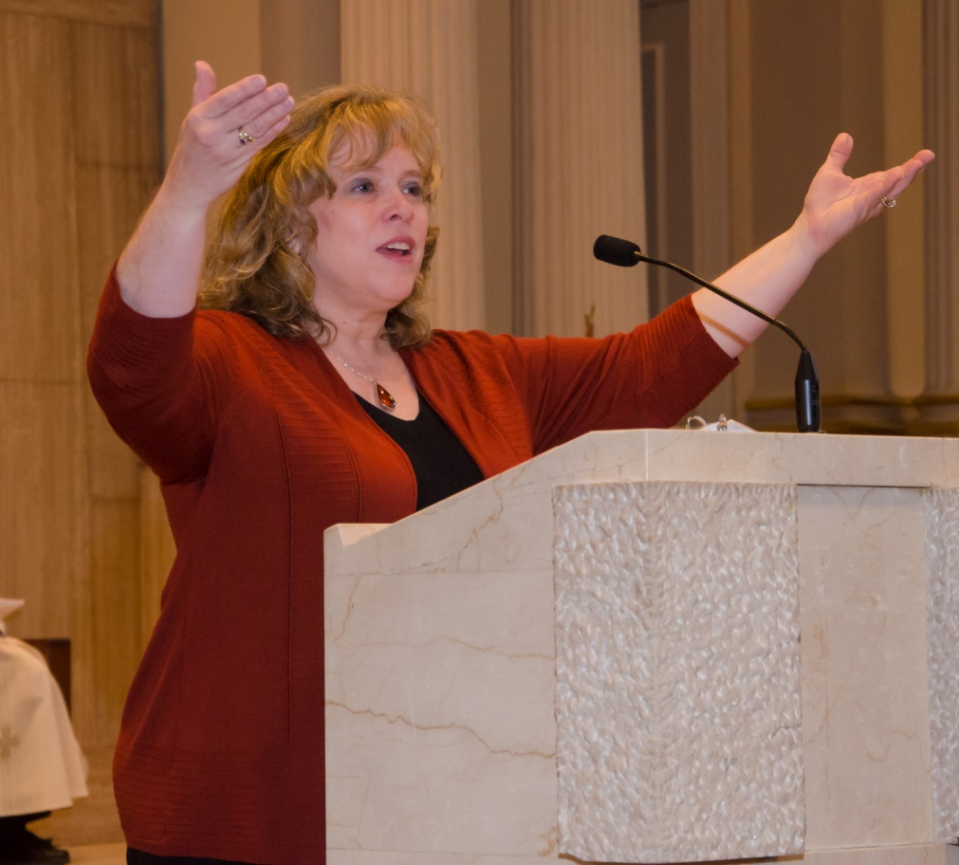
The
Role
of the
Cantor
Notes:
We turn now to look specifically at the role of the cantor. ()

Slide 14
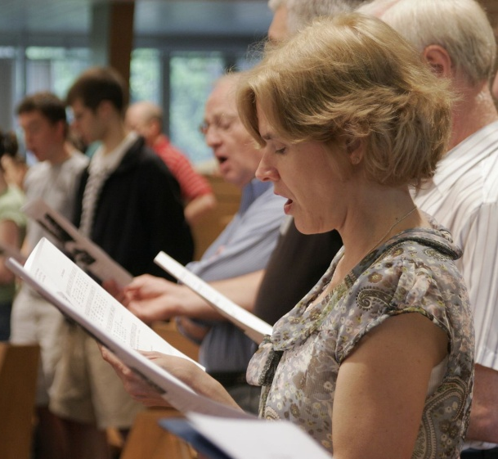
Why Do We Sing at Mass?
Sing to the Lord: Music in Divine Worship # 2
Song has individual and communal dimension
  Speaks to emotional part of human beings
    Left brain—understanding words and concepts
    Right brain—understands and communicates feelings
Unites our hearts and minds to each other in prayer
Expresses the sacramental presence of God (Mt 18:20)
Notes:
Sing to the Lord: Music in Divine Worship is a Church document issued by the United States Conference of Catholic Bishops that addresses the role of music in the liturgy. () It emphasizes the role of singing in the liturgy by stating that song has both an individual and communal dimension. () Singing is personal because it speaks to the emotional part of human beings () and incorporates both the left brain to understand words and concepts communicated by the song, () and also the right brain in communicating feelings. () Singing in the liturgy is also communal because each member of the assembly (we hope!) joins his or her voice with others in offering God praise and thanksgiving through song.
Through the sung participation in the liturgy, then, () members of Christ’s Body unite their hearts and minds to each other in prayer () and express the sacramental presence of God: “For where two or three are gathered together in my name, there am I in the midst of them” (Mt. 18:20). ()

Slide 15
Why Do We Sing at Mass?
    General Instruction of the Roman Missal #40
    “Great importance therefore should be attached to use of singing in the celebration of the Mass, with due consideration for the culture of the people and abilities of each liturgical assembly.”
    St. Augustine—
    “He who sings, prays twice.
Notes:
The General Instruction of the Roman Missal, which is the Church document that explains how the Mass is to be celebrated, also emphasizes the significance of sung participation of the faithful: () “Great importance therefore should be attached to the use of singing in the celebration of the Mass, with due consideration for the culture of the people and abilities of each liturgical assembly.”
Thus, singing is not simply something extra “added” to the liturgy but an important component that helps draw more out of ourselves, unites our hearts and minds with other members of the Body of Christ, and engages us in the full, conscious and active participation of the liturgy that is demanded of us by our baptism. () To quote St. Augustine, “He (or she) that sings, prays twice.”

Slide 16
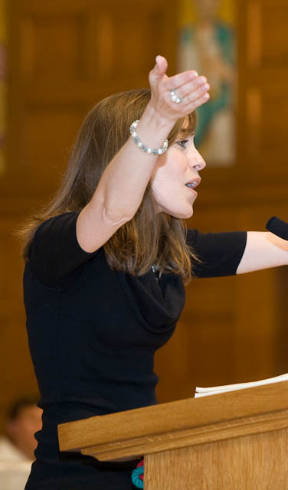
Role of the Cantor
Particular functions of the ministry:
General Instruction of the Roman Missal # 104:
  “It is fitting that there be a cantor or a choir director to lead and sustain the people’s singing. When in fact there is no choir, it is up to the cantor to lead the various chants, with the people taking part.”
Sing to the Lord Music in Divine Worship # 37
  Singer and leader of congregational song
  Cantor may sing in alternation or dialogue with assembly.
  May serve as psalmist
Notes:
The General Instruction of the Roman Missal describes the role of the cantor at Mass: ()
“It is fitting that there be a cantor or a choir director to lead and sustain the people’s singing. When in fact there is no choir, it is up to the cantor to lead the various chants, with the people taking part.” ()
Sing to the Lord: Music in Divine Worship is more specific regarding the role of the cantor and highlights three specific functions of the ministry. () First, that the cantor is the singer and leader of the congregational song. () Secondly, that the cantor may sing in alteration or dialogue with the assembly, () and third, that the cantor may incorporate the role of the psalmist, which was a specific liturgical role in early Christianity. In taking the role of psalmist, the cantor sings the responsorial psalm at Mass. ()

Slide 17
Basic Requirements of the Cantor
    Pleasant singing voice with which the community can be comfortable
    Voice with the ability to project and enunciate
    Confidence with singing and speaking in front of others
    Dedicated to preparation and rehearsal
Notes:
The basic requirements of the cantor include the following: ()
A pleasant singing voice with which the community can be comfortable. This doesn’t imply that the cantor should be a professional singer or needs to have a stellar voice, just that cantor’s voice should be at least pleasant enough that the assembly is comfortable listening to and singing with. ()
The cantor must have the ability to project and enunciate. Since one of the cantor’s responsibility is proclaiming the responsorial psalm through song, it is vital that he or she articulate every word of the text so that it is understood by the assembly. Cantor are also asked to announce the hymns or to make other announcements at Mass, so this also requires the ability to project and enunciate. ()
One of the most important qualities needed by the cantor is an overall confidence with singing and speaking in front of others. If one of the cantor’s responsibilities is serving as the leader of song, he or she must have confidence in what he or she is doing in order to be a leader to the community of faithful. ()
Of course, the cantor’s confidence is best acquired by knowing the music. This involves great dedication to preparation and learning the music. ()

Slide 18
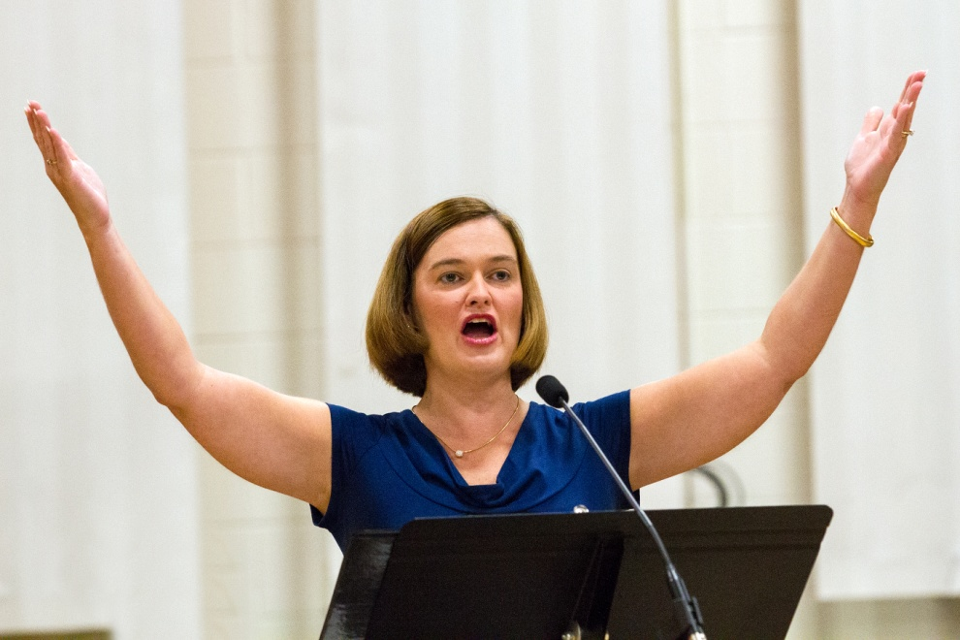
Basic Requirements of the Cantor
    Animated expression
    Prayerfully internalize the texts you sing
    An innate sense of hospitality
Notes:
Being a cantor also requires an animated expression. As a leader of song, the cantors can only animate the assembly if they are animated themselves. Having a pleasant facial expression and tone of voice when speaking does more to encourage sung participation than a cantor who is monotone and appears unhappy to be there. ()
Your expression as a cantor can be shaped by the how well you prayerfully internalize the texts you sing. How does the music connect with the readings of the day or the season we are in liturgically? Later we will talk about way you can reflect on and pray with the texts you sing at Mass. ()
All liturgical ministers should have an innate sense of hospitality. Remember that as a cantor, you are serving the community in aiding their prayer to God, and hospitality helps build rapport with the community you serve. ()

Slide 19
Basic Requirements of the Cantor
    Should be fully initiated Catholics in good standing and active members of the parish
    Must participate fully in the liturgy
    Ongoing prayer and formation in your ministry
Notes:
Cantors should also be fully initiated Catholics, that means having received all three sacraments of Initiation—Baptism, Confirmation and Eucharist—and they should be in good standing and active members of the parish. ()
As a liturgical minister, cantors should be a model for the rest of the community, so full participation in the liturgy is required. Even though the cantor is singing the hymns and acclamations, he or she also needs to be engaged in the responses, readings, homily and prayers of the Mass. ()
Cantors should also pursue ongoing prayer and formation in their ministry whenever it is available at your parish or in your diocese. ()

Slide 20
Discussion
Has music ever moved you to prayer?
Notes:
Does anyone have any questions so far?
After questions, continue on…
A question for our reflection and discussion: ()
Has music ever moved you to prayer?
After discussion, continue on… ()

Slide 21
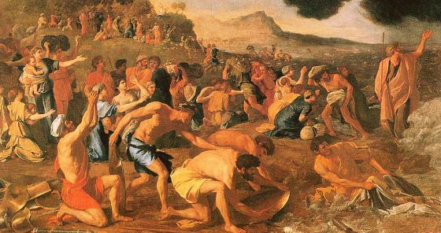
History of the Ministry of Cantor
Song of Moses—Exodus 15:20-21
One of the oldest compositions in the Bible
If traveling, they probably had a song leader
Notes:
Next, we turn to the history of the ministry of cantor. ()
We begin in the Old Testment with the “Song of Moses” found in the book of Exodus. [Consider reading the text from Exodus 15:20-21] () Scripture scholars believe this is one of the first and oldest compositions in the bible and that this song was the hymn sung as the Israelites marched on from the escape out of Egypt and the parting of the Red Sea. Witnessing the miraculous salvation of God and the freedom from slavery and death, the Israelites could not help but sing praise to God. In singing their joy to God while marching on to the Promised Land, () one could only assume that they had a song leader. This would be the earliest implicit evidence of a cantor.

Slide 22
History of the Ministry of Cantor
    The Psalms—the first cantor hymnal
      “Psalm” from Greek term psalmoi meaning “instrumental music”
      A total of 150 in number
      Expression various emotions, different structures, different purposes
      Attributed to King David, but probably written by a number of people over the course of a few centuries
      Used in Jewish worship but reinterpreted in Christ
Notes:
The psalms found in the bible could be considered the first cantor hymnal. () While a psalm is a type of song, the term “psalm” actually comes from the Greek term psalmoi meaning “instrumental music.” ()
The collection of psalms in the bible is arranged like that of a modern hymnal () in that each psalm is assigned a number totaling 150 () and they express various emotions, have different structures and serve different purposes in their use. () Although the psalms are attributed to King David, they were probably composed by a number of authors over the course of a few centuries. ()
While the popular belief is that the psalms were used extensively in Jewish worship at the time of Jesus, early Christians actually began to make use of the psalms more, reinterpreting them in the light of Jesus as the promised Messiah. ()

Slide 23
History of the Ministry of Cantor
Early Christianity
Emerging Christianity— “heightened” form of speech, some musicality
4th Century—psalmists perform psalm differently than other readings
Post-Constantine period—series of books developed containing various chants for Mass
8th Century
  series of books combined into full missal
  Priests began to “read” chanted texts
  Gregorian chant and polyphony developed
Notes:
In early days of the Church, we find that worship was similar to the practice in Jewish synagogues. () Worship did not involve “singing” as we know it today, but rather a “heightened” form of speech with some musicality to it, just short of chanting. ()
In the fourth century, the role of the “psalmist” begins to emerge in the Church’s liturgy, in which the psalmist performs the psalm differently, with more musicality than the other readings. ()
Following the legalization of Christianity by Constantine in 313, a series of books were developed containing the various Latin chants for the Mass. ()
In the eighth century, () these books of chant were combined into other books of prayers and readings for the Mass into full missals. Since these missals contained all of the texts of the Mass, () priests would gradually take on the responsibility of read all the parts of the Mass, including the chanted texts. () It was also during this period that Gregorian chant and polyphany, which is the layering of multiple chants lines on top of each other, would develop. ()

Slide 24
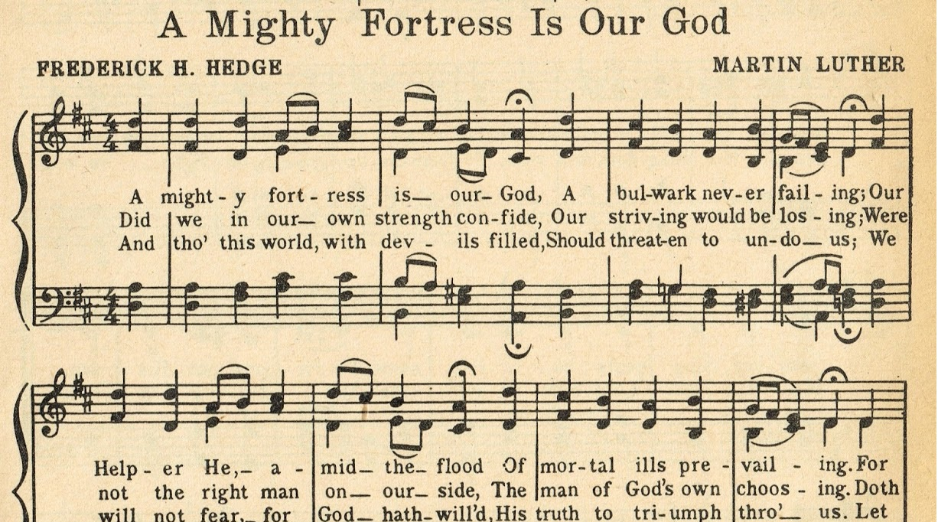
History of the Ministry of Cantor
16th Century—Protestant reformers began to develop vernacular hymnody that was singable and enduring
Notes:
In the sixteenth century, Protestant reformers began to develop their own style of music with vernacular hymnody meant to be singable by the congregation and more enduring. ()

Slide 25
History of the Ministry of Cantor
    Reforms of the Second Vatican Council—
    Constitution on the Sacred Liturgy (1963)
      Full, conscious and active participation of the faithful
      Use of the vernacular
      Expanded use of Scripture at Mass
      Strong emphasis on the participation in song—“Bishops and other pastors of souls must be at pains to ensure that whenever a liturgical service is to be celebrated with song, the whole assembly of the faithful is enabled…to contribute the active participation that rightly belongs to it” (CSL 114).
Notes:
In the twentieth century, () the Second Vatican Council brought many reforms to the Church. () The first document from the Council was the Constitution on the Sacred Liturgy which included several objectives. () The first and foremost being the full, conscious and active participation of the faithful in the liturgy. () This council also permitted use of the vernacular, or mother tongue, for the celebration of liturgy. () It expanded the use of Scripture at Mass throughout the year. () It also placed a strong emphasis on the sung participation of the faithful: () “Bishops and other pastors of souls must be at pains to ensure that whenever a liturgical service is to be celebrated with song, the whole assembly of the faithful is enabled…to contribute the active participation that rightly belongs to it” (CSL 14). ()

Slide 26
Discussion
How has singing made a difference in your life?
Notes:
Does anyone have any questions so far?
After questions, continue on…
A question for our reflection and discussion: ()
How has singing made a difference in your life?
After discussion, continue on… ()

Slide 27

The Sacred Liturgy
Notes:
We begin by taking a look at the importance of the sacred liturgy in the Catholic Church. ()

Slide 28
The Sacred Liturgy
  Catechism definition: “…the participation of the People of God in ‘the work of God.’ Through the liturgy, Christ, our redeemer and high priest, continues the work of our redemption in, with, and through his Church” (CCC 1069).
  Greek word—leitourgia—meaning “work done on behalf of the people.”
  “Work of God” accomplished through Christ in which we participate
          Silent
          Spoken
          Sung
Notes:
The Catechism of the Catholic Church defines liturgy () as “the participation of the People of God in ‘the work of God.’ Through the liturgy, Christ, our redeemer and high priest, continues the work of our redemption in, with, and through his Church” (CCC 1069).
The word “liturgy” may seem like an uncommon word. () It actually is based on the Greek word, leitourgia, meaning “work done on behalf of the people” or a public service. ()
More accurately in the Catholic Tradition, liturgy is understood properly as the “work of God” accomplished through Christ in which the faithful participate through the silent, spoken and sung prayer. ()

Slide 29
The Sacred Liturgy
  General term for the official public worship of the Church
  The source and summit of all activity in the Church (CSL 10)
  Various liturgy in the Church
      Eucharist (the Mass)—first and foremost
      The Sacraments
      Liturgy of the Hours
      Liturgy of the Word
Notes:
The word “liturgy” () is a general term for the official public worship of the Church, () and according to the Second Vatican Council document, Constitution on the Sacred Liturgy, liturgy is the source from which and the summit to which all activity in the Church flows. ()
There are various forms of liturgy in the Church: () first, and foremost is Eucharist, or the Mass. ()
All celebration of the sacraments would be examples of liturgy. ()
The Church marks time during the day through the praying of the Liturgy of the Hours. ()
And ritual in the Church that takes place within a celebration of the Word of God would be considered liturgy (Ash Wednesday, Rite of Election etc.) ()

Slide 30
The Sacred Liturgy
  The Life of the Church
    The work of our redemption accomplished
    Express and manifest to others the Paschal Mystery of Christ
  Christ is present in:
    The Eucharistic elements (par excellence)
    Person of the minister
    In the Sacraments
    In the Word proclaimed
    In the Church gathered (Mt. 18:20)
Notes:
The Sacred Liturgy is vital to the life and mission of the Church, () for in it, the work of our redemption is accomplished , () and the faithful express and manifest to others the mystery of Christ and the real nature of the Church. ()
We believe that Christ is continuously present to us through the sacred liturgy, and the Constitution on the Sacred Liturgy outlines the five ways that Christ is present: ()
First and foremost, in the Eucharistic elements of the consecrated bread and wine at Mass ()
Secondly, in the person of the minister ()
Third, in the celebration of the Sacraments ()
Fourth, in the Scripture readings proclaimed ()
Finally, in the Church gathered, for Jesus tells us in Matthew’s gospel, “For where two or three are gathered together in my name, there am I in the midst of them.” ()

Slide 31
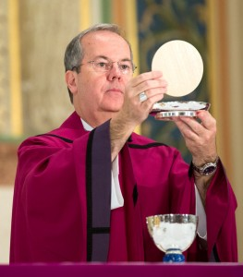
The Eucharist
    “The Eucharist, the sacrament of our salvation accomplished by Christ on the cross, is also a sacrifice of praise and thanksgiving for the work of creation. In the Eucharistic sacrifice the whole of creation loved by God is presented to the Father through the death and resurrection of Christ. “ (CCC 1359)
Christ’s sacrifice is perpetuated
We offer the sacrifice of ourselves to Christ’s sacrifice
The whole of creation is also offered to the Father.
Notes:
The celebration of the Mass, also known as Eucharist, is the most important liturgy that the Church offers. The Catechism of the Catholic Church tells us that () “The Eucharist, the sacrament of our salvation accomplished by Christ on the cross, is also a sacrifice of praise and thanksgiving for the work of creation. In the Eucharistic sacrifice the whole of creation loved by God is presented to the Father through the death and resurrection of Christ” (1359).
There is much contained in this definition, but it could be summed up in the following points about what happens in the Eucharist: ()
The sacrifice of Christ on the cross is perpetuated and remembered until he comes again (“When we eat this bread and drink this cup, we proclaim your death, O Lord, until you come again.”) ()
We join the sacrifice of ourselves (our struggles, our hopes, our joys etc) to Christ’s sacrifice out of praise and thanksgiving to God. ()
The whole of creation, redeemed and renewed through Christ is also offered to the Father. ()
In a sense, the Eucharist much bigger than just the parish community, but is offered for the life of the whole world.

Slide 32
The Eucharist
    Future Glory:
    “In the earthly liturgy, we take part in a foretaste of that heavenly liturgy celebrated in the holy city of Jerusalem toward which we journey as pilgrims…” (CSL 8)
Notes:
The Eucharist also gives us a taste of our future glory in heaven: () “In the earthly liturgy, we take part in a foretaste of that heavenly liturgy celebrated in the holy city of Jerusalem toward which we journey as pilgrims…” (CSL 8) While on earth, we join our voices with all of the angels, saints, and the faithful in heaven as they offer never-ending praise to God in heaven. ()

Slide 33

Music in the Mass
Introductory Rites
Entrance Chant—“The purpose of this chant is to open the celebration, foster the unity of those who have been gathered, introduce their thoughts to the mystery of the liturgical season or festivity, and accompany the procession of the priest and ministers” (GIRM 47)
Penitential Act (Kyrie) or Sprinkling Rite
Gloria—“The Gloria is a very ancient and venerable hymn in which the Church, gathered together in the Holy Spirit, glorifies and entreats God the Father and the Lamb” (GIRM 53)
Notes:
Next, we will look at the specific parts of the Mass that are sung and explain their function within the Mass. ()
The first part of Mass is called the Introductory Rite, which “introduces” and prepares us for the sacred mysteries we are about celebrate. () It consists of the Entrance Chant, or song, whose “…purpose is to open the celebration, foster the unity of those who have gathered, and introduce their thoughts to the mystery of the liturgy time or festivity, and accompany the procession of the Priest and ministers” (GIRM 47). ()
Immediately following the Sign of the Cross and Greeting is the Penitential Act in which the faithful are invited to call to mind their sins, and ask the Lord for mercy. There is always an option on Sundays for the priest use the Sprinkling Rite as a reminder of our Baptism in place of the Penitential Act. () Unless it was already part of the Penitential Act, the Kyrie (Greek for “Lord”), or Lord, Have Mercy is sung or said, with the cantor singing the tropes acclaiming the Lord and imploring his mercy. ()
Then the Gloria, or Glory to God, which is an ancient hymn in which the Church, gathered in the Holy Spirit, glorifies and entreats the Father and the Son. Ideally, this great hymn should be sung on Sundays, solemnities and feasts of the Church except on the Sundays of Advent and Lent, although it may be recited as well. ()

Slide 34
Music in the Mass
Liturgy of the Word
Psalm Response
  intended to foster reflection on the First Reading
  “Because the Psalm is properly a form of sung prayer, every means available in each individual culture is to be employed in fostering the singing of the Psalm at Mass…” (STL 158).
  Since it is part of the Scripture proclaimed at Mass, the psalm should be sung from the ambo
Notes:
The next part of the Mass is the Liturgy of the Word, where God speaks to his people and opens our hearts and minds to the mystery of our salvation in Christ. ()
The Responsorial Psalm is selected () to foster reflection upon the First Reading at Mass. () According to Sing to the Lord, “Because the Psalm is properly a form of sung prayer, every means available in each individual culture is to be employed in fostering the Psalm at Mass…” (STL 158). ()
Since the Responsorial Psalms is part of the Liturgy of the Word and part of Scripture that is proclaimed at Mass just like the First Reading, Second Reading and Gospel, the psalm should be sung from the ambo. ()

Slide 35
Music in the Mass
Gospel Acclamation
  Alleluia (except during Lent) with solo verse
  Alternate acclamations used during Lent
  May be repeated to accompany the length of the Gospel procession
  If not sung, it may be omitted.
Universal Prayer (Prayer of the Faithful)
Notes:
The Liturgy of the Word reaches its high point with reading of the Gospel. () In the liturgy we treat this moment with great respect and honor when everyone stands, the Book of the Gospels is carried in procession and the Alleluia acclamation is sung. This Hebrew word means “praise God” and is usually associated with Easter. The cantor usually sings the verse, which is usually a line from the gospel reading we are about to hear or a scriptural verse that pertains to the feast or season. () We refrain from the “Alleluia” during Lent in anticipation of Easter joy, and substitute an alternate acclamation. () The acclamation may be repeated to accompany the duration of the gospel book procession. () If the Alleluia or gospel acclamation cannot be sung, it is to be omitted altogether. ()
Finally, we respond to the Word of God proclaimed and the faith we have professed by offering the Universal Prayer. Also known as the Prayer of the Faithful, these intercessions express our concern for the entire Catholic Church, the needs of the world, our nation, the poor, our community, the sick and for those who have died. Some parishes will have the assembly sing the response to each intercession, have the cantor chant each intercession with a sung response by the assembly, or simply have the cantor speak the intercessions instead of the deacon or lector. ()

Slide 36
Music in the Mass
Liturgy of the Eucharist
Preparation of the Gifts
The Eucharistic Prayer—
  “In order to make clear the ritual unity of the Eucharistic Prayer, it is recommended that there be a stylistic unity to the musical elements of the prayer, especially the Sanctus, the Memorial Acclamation and the Great Amen” (STL178).
Notes:
Mass then transitions into the second part, () known as the Liturgy of the Eucharist. () During this transition called the Preparation of the Gifts, the altar is prepared and the offerings of the faithful are collected. This is an opportunity for music, but not necessarily congregational singing. You parish music director may schedule an instrumental or choral selection during the Preparation of the Gifts.
Next, we move into the center and high point of the entire Mass: () The Eucharistic Prayer. This great prayer begins with the priest inviting us to lift up our hearts to the Lord in praise and thanksgiving. Throughout the prayer, there are various acclamations sung by the assembly. Sing to the Lord instructs, () “In order to make clear the ritual unity of the Eucharistic Prayer, it is recommended that there be a stylistic unity to the musical elements of the prayer, especially the Sanctus, the Memorial Acclamation and the Great Amen.”
For this reason, many parishes will use acclamations that come from the some collection, such as Mass of Creation, Mass of Christ the Savior, Mass of Renewal etc. These mass settings include all the Eucharistic acclamations and are usually written by the same composer and feature similar musical style or theme throughout. ()

Slide 37
Music in the Mass
Sing to the Lord: Music in Divine Worship
Sanctus/Holy, Holy, Holy—“the great cosmic acclamation of praise” (180)
Memorial Acclamation—“by which the faithful participate in keeping the memory of Christ’s Paschal Mystery” (180)
Amen—“by which they give their assent to the entire prayer” (180).
Notes:
There are three Eucharistic Acclamations, the Sanctus, or the Holy, Holy, Holy; the Memorial Acclamation; and the Amen. ()
The Sanctus is ancient hymn first recorded in the book of the prophet Isaiah and also found in the book of Revelation describing the vision of the Lord in his glory in heaven. As the Eucharistic Prayer begins, we, faithful here on earth, join our voices with all those in heaven in praising God using this ancient hymn. Sing to the Lord describes the Holy, Holy, Holy as “the great cosmic acclamation of praise.” ()
The Memorial Acclamation immediately follows the Institution Narrative and the invitation of the priest, “The mystery of faith.” By singing this acclamation, “the faithful participate in keeping the memory of Christ’s Paschal Mystery.” ()
At the conclusion of the prayer, the priest offers praise to the Blessed Trinity in the doxology, and the faithful give their assent to the entire Eucharist Prayer through the Amen. ()

Slide 38
Music in the Mass
The Fraction Rite (Agnus Dei)
Sung by the choir or cantor with the congregation responding
Should accompany the ritual action for as long as it takes
“Lamb of God” is the only invocation to be used
Notes:
During the Fraction of the Bread, the Lamb of God (Agnus Dei) is sung, and the consecrated bread is broken, just as Christ did at the Last Supper, and signifies that we, the faithful, belong to the one Body of Christ. Referring to Jesus as the “Lamb of God” bears a connection to the Passover lamb that is sacrificed in the Jewish tradition. Jesus has become our Paschal (Passover) Lamb by his sacrifice on the cross. () As his Body is broken at Mass, we recall how he was broken on the cross for our sins and implore him to have mercy on us even now. ()
The Lamb of God litany can accompany the ritual action for as long as it takes, but must be sung at least three times through with the final phrase, “grant us peace.” () Please note that “Lamb of God” is the only invocation to be used (not “Bread of Life,” “Saving Cup” etc.).

Slide 39
Music in the Mass
The Communion Chant
“Its purpose is to express the communicants’ union in spirit by means of the unity of their voices, to show joy of heart, and to highlight more clearly the ‘communitarian’ nature of the procession to receive Communion” (GIRM 86).
“The singing begins immediately and continues for as long as the Sacrament is being administered to the faithful.” (GIRM 86)
Notes:
Following the invitation to Communion, the Communion Chant or song begins. Both the General Instruction of the Roman Missal and Sing to the Lord provide clear directives for the music at this point in the Mass: ()
“Its purpose is to express the communicants’ union in spirit by means of the unity of their voices, to show joy of heart, and to highlight more clearly the ‘communitarian’ nature of the procession to receive Communion” (GIRM 86). Thus, the objective of the Communion Song is to unite spiritually those members of the mystical Body of Christ about to receive the sacramental Body of Christ. ()
The General Instruction is also clear when this song begins and when it should end: “The singing begins immediately and continues for as long as the Sacrament is being administered to the faithful” (86). ()

Slide 40
Music in the Mass
The Communion Chant
“It is recommended that psalms sung in the responsorial style, or songs with easily memorized refrains be used.” (STL 192)
“Care should be taken to ensure that the musicians (singers and instrumentalists), too, can receive Communion with ease.’” (STL 195)
Notes:
As far as the type of songs that should be used for the Communion Chant, Sing to the Lord states, “It is recommended that psalms sung in the responsorial style, or songs with easily memorized refrains be used” (192). This allows communicants to sing when in the communion procession and they don’t have the words in front of them. ()
Regarding their ministry and receiving Holy Communion, Sing to the Lord recommends, “Care should be taken to ensure that the musicians (singers and instrumentalists), too, can receive Communion with ease” (195). ()

Slide 41
Music in the Mass
The Recessional Hymn
Optional
Sending Forth function
Notes:
Interesting to note, the “Recessional Hymn” is not required nor is it even mentioned in the Roman Missal. This is a tradition that has developed in the Mass, but is not an official part of the Mass. It makes sense not to have a “Closing Hymn” since the final words of the priest or deacon are a commandment to “announce the gospel through your life.” Singing a song seems to postpone that command to live what we have just celebrated. () Thus, the Recessional Hymn is optional. () If you parish chooses to sing a Recessional Hymn regularly, a song that functions as a “sending forth” is most appropriate.

Slide 42
Music in the Mass
Other music in the liturgy
Chanted responses/dialogue
  Greeting
  Kyrie
  Alleluia
  Prayer of the Faithful
  Preface dialogue
  The Lord’s Prayer
  Agnus Dei
  Dismissal
  Double Alleluia Dismissal
Occasional chants
  Litany of the Saints
  Sequence (Easter & Pentecost)
Notes:
Some parishes may choose to chant the ordinary (the Mass responses that don’t change from week to week) of the Mass. Cantors in these parishes will need to know these specific chants such as the greeting, (“The Lord be with you. And with your spirit.” or some variation), a simple chanted version of the Kyrie, the Alleluia, the Prayer of the Faithful, the Preface Dialogue to the Eucharistic Prayer, the Lord’s Prayer, the Lamb of God (frequently chanted in Latin), the Dismissal (“Go in peace. Thanks be to God.” or some variation), and the Double Alleluia Dismissal used on Easter Sunday, the Octave of Easter including Divine Mercy Sunday, and Pentecost.
Certain feasts and liturgies require the singing of the Litany of the Saints and the Sequence, which immediately follows the Second Reading.
Even if your parish doesn’t sing the traditional chants in the Mass, it would be a good idea for the cantor to learn these dialogues since they are part of the rich liturgical tradition in the Catholic Church. ()

Slide 43
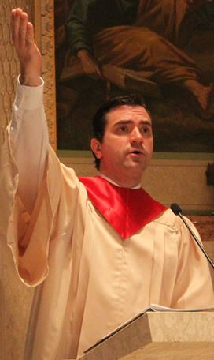
Serving
as a
Cantor
at Mass
Notes:
Next, we turn our focus to serving as a cantor at Mass. ()

Slide 44
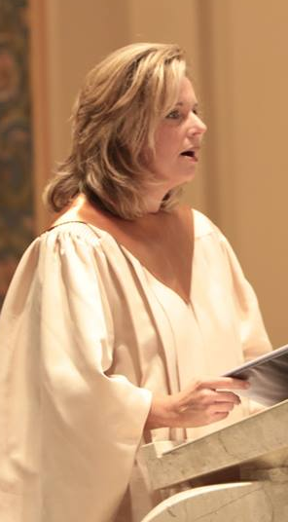
Serving as a Cantor at Mass
Advanced Preparation = CONFIDENCE
Knowing the music for Mass in advance
Make arrangements with organist/accompanist to practice
Learn new music
Recordings of the music (require copyright permission)
Review introductions and interludes
Notes:
Adequate and advanced preparation for this ministry is extremely important, because, as mentioned earlier, such advanced preparation leads to confidence which is essential to this ministry. Advanced preparation includes: ()
Knowing what music you will be singing for Mass well in advance. Many music directors will plan music for a whole liturgical season (almost three months) in advance. ()
Making arrangements with the organist or accompanist to practice. Today, many people have hectic schedules and cannot always find time to meet with the organist to rehearse. Alternatives to meeting every time you are scheduled to cantor include meeting once to practice all of the music, or at least new music for an entire liturgical season. ()
Some music directors find it helpful to record the music for a season digitally and then burn it to a CD to distribute to cantors, or some email or text the recordings. This requires securing the necessary copyright permissions from the music publishers. Recording the music for cantors gives them the opportunity to practice on their own time, () although practicing the music at least once with the organist before Mass is still highly recommended to review introductions and interludes to songs. ()

Slide 45
Serving as a Cantor at Mass
Practice and review the music on your own
Develop a great familiarity and comfort with the melody
Just listen to the melody first
Develop an ear for it so that you can hum it on your own
Notes:
When you practice and review the music on your own time, () you will want to develop a great familiarity and comfort with the melody line, since this is the part that you will be singing and leading the assembly on. If it is a new selection, () just listen to the melody line multiple times first, () developing an ear for it so that you can gradually hum it on your own. ()

Slide 46
Serving as a Cantor at Mass
Preparing the Psalm
Read the Psalm aloud
add the proper pauses and inflections
the emotion conveyed through interpretive reading should be the same when you sing it
Pray with the psalm
  Read through First Reading
  Look at the other readings for the day
Notes:
Remember that in singing the Responsorial Psalm at Mass, you are actually proclaiming one of the readings at Mass, you just happen to be singing it. Since the Responsorial Psalm is one of the readings at Mass whose verses the cantor sings by himself or herself, extra preparation is required so that the message of the psalm is heard and understood by the assembly. ()
First read the psalm aloud as if you were reciting poetry to a group (because that’s essentially what the psalm is!). () Be sure the add the proper pauses and inflections when reading it aloud to ensure the proper expression of what the text is trying to express. () The bottom line with doing this preparation is that the emotion conveyed through the interpretive reading should be the same as when you sing it. ()
Consider making the psalm you are singing part of your prayer for the week. () Since the Responsorial Psalm was chosen as a “response” to the First Reading, you may want to look at that reading to see the connection between the two, () or even look at the other readings for the day to gain a better appreciation of the psalm text. ()

Slide 47
Serving as a Cantor at Mass
Preparing the Psalm
“Take your time…but hurry up”
“Put on the brakes”
“You’re proclaiming the psalm, you just happen to be singing it.”
Notes:
If you are singing the verses of the Responsorial Psalm on a psalm tone, () you need to take your time…but hurry up. This means sing to slowly and deliberately enough so that the assembly understands every word, but hurry up so that you are not dragging out the phrases so much that the meaning is lost. The text sung to a psalm tone should flow as if you were speaking the text.
The danger with allowing the text of a psalm tone to “flow” is that the cantor can “runaway” with the text before realizing the note of the psalm tone changes. () This requires the cantor to “put on the brakes” meaning to slow down just before the end of the phrase so that you can safely “turn” and change of pitch of the psalm tone. If you look at Responsorial Psalms with psalm tones, you will notice that the text of the verses have strategic “gaps” between so that you can tell where the pitch is going to change. Upon approaching the gap, the cantor should “put on the brakes” and slow the text down so that he or she can be ready vocally to change to pitch.
Overall, remember that the Responsorial Psalm is different from any of the other music you will be singing at Mass. Since it is part of the Liturgy of the Word and is part of Sacred Scripture, it should be prepared and sung differently than the other music at Mass. As a cantor taking on the role of a psalmist, () always remember that “you are proclaiming the psalm, you just happen to be singing it.” ()

Slide 48
Serving as a Cantor at Mass
Hymns and Acclamations
Pray with the text, perhaps look at the readings and look for connections
Practice singing with music
Acclamations and the Lamb of God should be nearly memorized
Notes:
Other principles to remember:
As with the Responsorial Psalm, () pray with the text of hymns selected for a particular Mass and consider looking at the readings for that day to look for connections. ()
Even if you rehearse on your own, it is important that you sing through the music with the organist or pianist prior to the liturgy. The accompaniment, introductions or interludes may sound different than what you are used to. ()
All of the acclamations and the Lamb of God at Mass should be nearly memorized, especially if they are newer settings that the assembly is still learning. By having the acclamations memorized, the cantor can be an effective leader for the assembly’s sung participation. ()

Slide 49
Serving as a Cantor at Mass
Attire
  “Bodily demeanor (gestures, clothing) ought to convey the respect, solemnity and joy of the moment when Christ becomes our guest” (CCC 1387b).
dress in a way that is dignified and shows respect for the Blessed Sacrament and your function as a cantor at Mass
Nothing should be worn that calls attention to the cantor, such as logo shirts or revealing clothing
Notes:
On the day of your scheduled ministry, your preparations begin at home. () The first is your attire and what you will wear for your ministry. ()
The Catechism of the Catholic Church tells us that “Bodily demeanor (gestures, clothing) ought to convey the respect, solemnity and joy of the moment when Christ becomes our guest” (1387b). ()
In other words, you want to dress in a way that is dignified and shows respect for the Blessed Sacrament and your function as a cantor, sometimes referred to as wearing your “Sunday best.” () That means that nothing should be worn that calls attention to yourself, such as logo t-shirts and revealing clothing. Your parish may have specific requirement as to what you should wear for your ministry. ()

Slide 50
Serving as a Cantor at Mass
Procedure before Mass
Begin to warm up your voice at home—please do not count on the organist or accompanist to do this for you.
Stretching—yawning, chewing, rolling and massaging the neck and shoulders, massaging your face
Continue with vocal exercises, beginning with descending scales first, humming tritones with the lips loosely together so they vibrate
Sing lightly at first and then gradually grow in energy
Notes:
Since proper vocal warmups take time, () you should begin warming up your voice at home. Please do not count of the organist or accompanist to do this for you—he or she has enough responsibilities before Mass.
Although you may have your own series of vocal warmups, some suggested exercises include: ()
Stretching. This includes yawning, chewing, rolling and massaging your neck and shoulders, and massaging your face. ()
Continue with vocal exercises, beginning with descending scales first, by humming tritones with the lips closed, but loosely together so they vibrate. ()
Sing lightly at first, and then gradually grow in intensity and energy as you begin to warm up.
Your parish music director will have specific exercises he or she can demonstrate to you. ()

Slide 51
Serving as a Cantor at Mass
Arrive well before the scheduled Mass time
You should already know the music you are going to be singing, although you may have to be flexible with some details or last-minute changes
Review introductions and interludes with the organist or accompanist
Know what cues from the organist/accompanist mean what
Check in with the priest, deacon or sacristan for the Mass regarding any musical matter that may affect him or for any out of the ordinary in the liturgy that may affect the music
Notes:
On the day of your scheduled liturgy, () you should arrive well before the start of Mass, especially if you want to review the music with the organist or accompanist. Plan to arrive at least 15 or 20 minutes prior to Mass. ()
You should already know the music you are going to be singing for the liturgy, although you may have to be flexible with any last-minute details or changes. ()
Be sure to discuss and/or review introductions and possible interludes within the music with the organist or accompanist () and also discuss what cues mean what, such as signals for final verse, repeating refrain, closer to the microphone etc. ()
Also, consult the priest regarding anything musical matter that may affect him or for anything out of the ordinary taking place in the liturgy that may affect the music. ()

Slide 52
Serving as a Cantor at Mass
Know when you are to receive Communion
Make any adjustments necessary to your chair or microphone (microphone properly lined up with your mouth, especially looking down at the music)
Consult your parish music director about any other preparations you should make before Mass
Spend the last few minutes before Mass in personal prayer
Notes:
Other logistics that the cantor should know are: ()
When to receive Communion—some parishes ask the cantor to receive Communion at different times so that the Communion Song can begin in a timely matter. Be sure what the practice for cantors is in your parish. ()
Make sure to make any adjustments necessary to your chair or microphone prior to Mass. When adjusting the microphone, be sure that it lines up properly with you mouth, especially when looking down at the music. Often times, the cantor’s volume greatly decreases whenever he or she looks down at the music. ()
Consult your parish music director regarding any other preparations you should make before Mass. ()
Be sure you’ve made all these preparations early enough so that you can spend the last few minutes before Mass in prayer before you begin your ministry. ()

Slide 53
Serving as a Cantor at Mass
Rehearsal with the congregation before Mass
Keep it short and concise
Sing through it once, ask the assembly to repeat it twice
If a longer refrain, ask them to repeat a phrase after you, and then put the whole thing together twice
This is best and more efficient unaccompanied
Only do this when needed—specifically for refrains or acclamations where the congregation doesn’t have a book in front of them
Notes:
If you parish asks you to rehearse new music with the assembly before Mass, () be sure to keep it short and concise. () After the organist has played through the melody line for an introduction, sing through the selection alone once, and ask the assembly to repeat it twice. () If a longer a refrain, invite them to repeat each phrase after you, and then put the whole refrain together twice. () Most of the time, teaching new music is best accomplished unaccompanied on organ or piano, so confidence in singing along with just the melody line is essential. () Only rehearse new music when needed, especially for refrains or acclamations during the Mass when the assembly doesn’t have the text in front of them. ()

Slide 54
Serving as a Cantor at Mass
Cantor as a visual ministry
“A true cantor lets the congregation know that the best compliment they can give is to join in” (The Parish Cantor Michael Connolly).
More than having a good singing voice, the cantor needs to engage the congregation in order to foster their sung participation
Eye contact—especially at the beginning and end of refrains and verses
Arm gestures
  Cued whenever assembly’s turn to sing
  Sync with inhalation
Notes:
Even though we associate the ministry of cantor with vocal skills, () you want to consider your service as a visual ministry. () In his book, The Parish Cantor, Michael Connolly writes, “A true cantor lets the congregation know that the best compliment they can give is to join in.” () Thus, more than having a good singing voice, the cantor needs to engage the congregation in order to foster their sung participation. ()
For this reason, eye contact is extremely important, especially at the beginning of refrains when you are cueing the assembly to sing. The ends of the refrains and verses are also opportune times to establish eye contact with the assembly since you are usually sustaining the note. ()
Arm gestures are visual cues utilized to let the assembly know it is time to sing. They become absolutely necessary when new music is sung or for hymns with interludes or long introductions. Using one or two arms, cueing gestures should be confident and involve full extensions of the arm with the palm of the hand facing up. () They to be used any time it is the assembly’s “turn” to sing. () The timing of these gestures should be in sync with your inhalation—as you breathe in, arm goes up. ()

Slide 55
Serving as a Cantor at Mass
Making announcements slowly and clearly
Give them time to find their page in the hymnal
Get them started on a song they are familiar with and then back off
Continue to sustain the singing if it’s a newer song
Conveying a presence that you’re happy to be there (and that you’re happy THEY’RE there too)
Smile ☺
Notes:
Be sure to make announcements slowly and clearly so the assembly can understand what you are saying, especially the song number and title. () Be sensitive of the time needed for members of the assembly to find the correct page in their hymnals and also the time needed for them to sit down for the beginning of the preparation of the gifts. If they are still trying to sit down while you are making the announcement for the next song, they will miss the title and number. ()
Although the cantor’s role is to foster the singing of the assembly, the cantor should never dominate it. If singing a hymn or acclamation that the community is familiar with, the cantor should “get them started” with the first few words of the song or acclamation, and then back off the microphone. () If it is a newer song or acclamation, the assembly will depend on the cantor more, so he or she should sustain the singing by staying closer to the microphone. ()
Overall, be hospitable and convey a presence that you’re happy to be serving in this ministry, and that you’re happy the assembly is there too! () The best way to do this is to smile. ()

Slide 56
Serving as a Cantor at Mass
“Troubleshooting”
No matter what: DON’T STOP SINGING
Establish “preset rules” with organist/accompanist
  What to do if a cantor/organist accidentally skips a verse
  What to do if a cantor fails to come in at the correct time
  If the cantor can’t see gestures from the organist, develop “listening cues”
Sound delays in churches
Organist/Accompanist sets the tempo
Notes:
As with any liturgical ministry, () you may make mistakes or run into certain problems or issues. () No matter what happens, DON’T STOP SINGING with the exception of a true emergency. Most of the time if a mistake is made and the cantor continues singing, the assembly doesn’t even notice. () To anticipate mistakes, it helps if the cantor establishes “preset rules” with the organist or accompanist, such as what to do if a cantor or the organist accidentally skips a verse, what to do if the cantor fails to come in at the correct time, or if the cantor can’t see the organist and accompanist. Overall, if a mistake is made, it is important to remain calm and continue with your ministry. ()
Another issue cantors may face are sound delays in large worship spaces. This is a challenge not easily overcome except with acoustical adjustments and adequate sound equipment. To compensate for sound delays, cantors should “anticipate” the music coming from the organ or piano and try to keep pace with the tempo first established by the organist or accompanist. () As a rule, the organist/accompanist sets the tempo, and the cantor should follow him or her. ()

Slide 57
Questions?
Notes:
Does anyone have any questions?
After questions, continue on with the practicum.

Slide 58
Practicum

